Slide 1
WELCOME TO YEAR 5
2024 -2025

Slide 2
TEACHING STAFF
Unicorn ~ Mr Dave (Class Teacher)
Hercules ~ Miss Toms (Class Teacher)
Our Support Staff are: Mrs O’Brien, Mrs Kumar and Miss Barry (Mon and Tues)
The class teachers PPA time will be covered by
LEO PE lessons and Lingotots

Slide 3
OUR SCHOOL DAY:
Time | Activity
08:35 | Register/Early work
08:50 | Worship
09:15 | Maths
10:15 | Break
10:30 | English
11:30 | Guided Reading
12:00 | Lunch
13:10 | Spelling/Handwriting
13:25 | Topic/PE etc
14:20 | Topic/PE etc
15:20 | End of school day

Slide 4
DAILY READING
Reading at school will be a range of individual, group and whole class reading.
Reading at home ~ please ensure that your child is reading for at least 15 minutes every day. The children should fill this in in their Home/School books ready for you to sign at the end of the week.
It is important that the children are reading aloud to you sometimes and discussing what they have read. Encourage them to ask questions, find out the meaning of unfamiliar words, predict what might happen next, find evidence in the text for the behaviour etc of characters.

Slide 5
SPELLING
Spelling patterns will be taught during the week and may sometimes be part of the English Homework. We are following the No Nonsense spelling scheme.
The main pattern focuses for Y5 are: words ending with -cious/-tious; -cial/-tial; -ant, -ance, -ancy/-ent, -ence, ency; -able, -ably/-ible, -ibly. Words with ‘ough’, words with silent letters and homophones (words that sound the same but with different spellings and meanings e.g aloud/allowed).
Please refer to the spelling lists in Google Classroom to continue to support your children in the learning of these spellings. These will be uploaded this afternoon.

Slide 6
ENGLISH

Slide 7
TIMES TABLES
Every child is now expected to know their tables up to 12 x 12 by the end of Year 4.
If you know your child has not yet achieved this, please do all you can at home to help them practise.
Times table knowledge will be used in lessons during the week but they may not be formally tested on them.
Please encourage your child to use Times Tables Rockstars and Mathletics as much as possible. If your child does not have a log in for either please let the class teacher know.

Slide 8
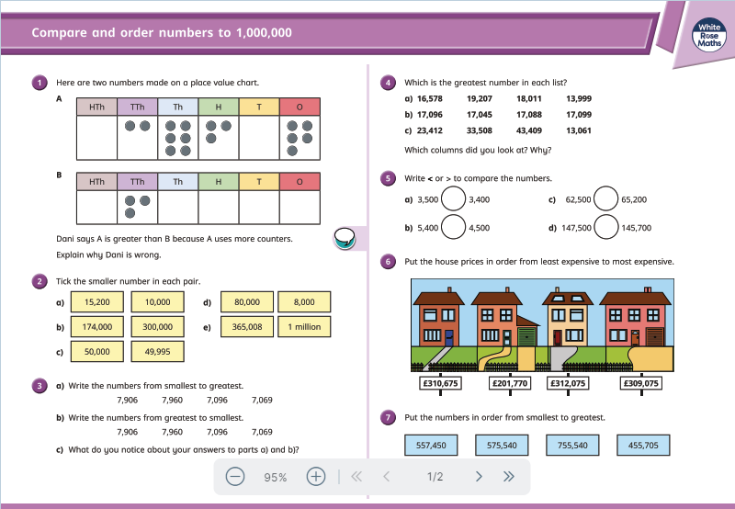
MATHS LESSONS

Slide 9
HOMEWORK
This will be set on Thursdays and needs to be in by the following Tuesday. These tasks will be set on Google Classroom.
There will be Maths and English homework every week.
They should spend no more than 30 minutes on each piece of work.
Topic homework suggestions will be given out each half term. Children are expected to complete three activities by the end of the half term (before the half-term break).

Slide 10
THE CURRICULUM
Expectation of children’s achievement is high.
The curriculum is broken down into expectation for each year group as bands and steps.
The curriculum is available online if you wish to have a look at it.

Slide 11
ASSESSMENT
Children will be taught the Band 5 curriculum and assessed against this.
Children will make progress of steps through the band.
There is an emphasis on broadening children’s learning and ensuring they are secure in their new skills.

Slide 12
TOPIC BASED TEACHING
All work will generally be topic based, with the exception of maths and RE.
Each half term will encompass a different topic.
The topics cover all topics in our National Curriculum.

Slide 13
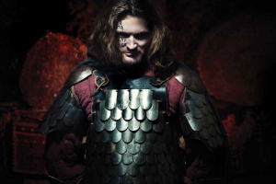
PEASANTS, PRINCES AND PESTILENCE
Aut 1 ~ History Focus

Slide 14
STARGAZERS
Aut 2 ~ Science Focus

Slide 15
ALCHEMY ISLAND
Spring 1 ~ Science/Music/computing focus

Slide 16
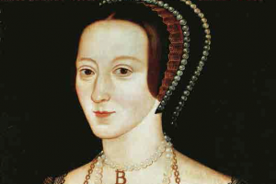
OFF WITH HER HEAD
Spring 2~ History Focus - Tudors

Slide 17
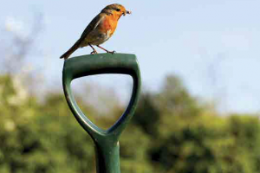
ALLOTMENTS
Summer 1 ~ Geography/science focus

Slide 18
TIME TRAVELLERS
Summer 2~ PHSE (Puberty)/Art/science focus

Slide 19
TRIPS/EVENTS
Dalesdown Parents’ Meeting - Thursday 23rd of January at 6:00pm
Dalesdown residential trip 30th April 2024 - 2nd May 2024
Swimming - Every Wednesday afternoon from Wednesday 13th November to Wednesday 22nd January.
We will not be swimming on Wednesday 18th December
Parental help will be needed for these afternoon sessions.
Visit to Sutton Synagogue will be booked in the half term after Christmas Parental help will be needed for this morning session.
During the Off With Her Head topic there will be a Tudor Day.
A mobile Planetarium is in the process of being booked that links to our Stargazer topic after October half term.

Slide 20
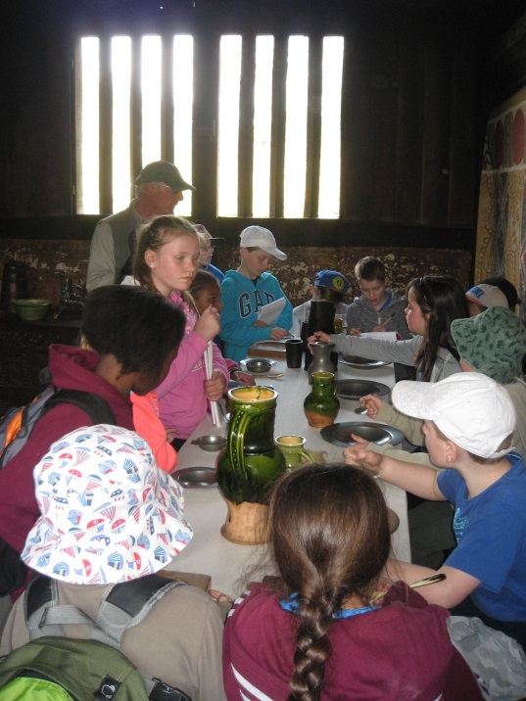
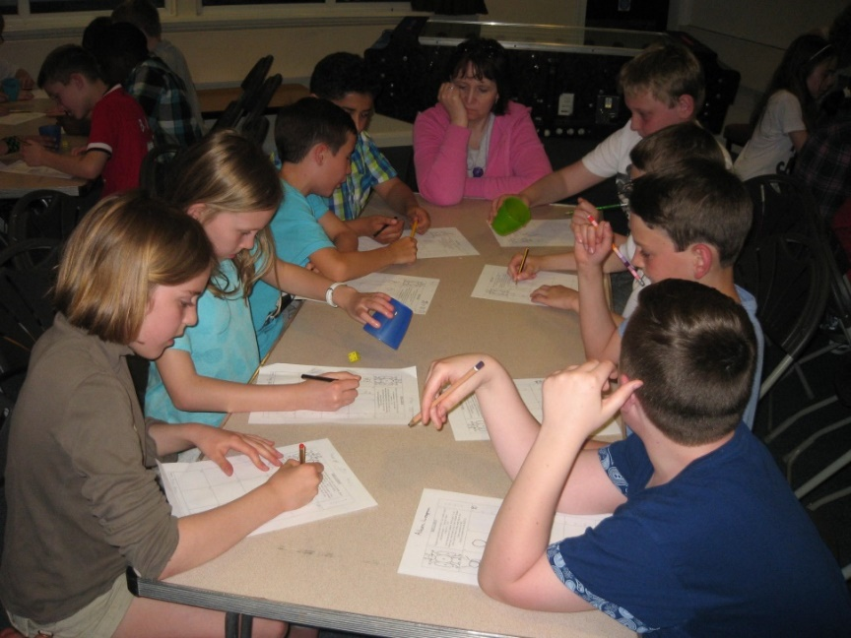
DALESDOWN
3-day residential trip.
Wednesday 30th April to Friday 2nd of May 2024
There will be a meeting about the trip on the evening of

Slide 21
GENERAL
If your child is being collected by someone other than their parent/carer, please write this in the home/school book.
If, later in the year, your child begins to walk to or from school on their own, please complete a ‘Walking to School’ form available from the office or class teachers.
If your child is walking on their own and you wish them to bring a mobile phone to school, please ask the class teacher for a ‘Mobile Phone Agreement’ form which will need completing by the child and parent.
Please ensure that children are wearing their PE to school on the appropriate day.
When Year 5 begin swimming, the children will only need to wear PE kits to school on a Thursday.

Slide 22
ANY QUESTIONS?

