Slide 1
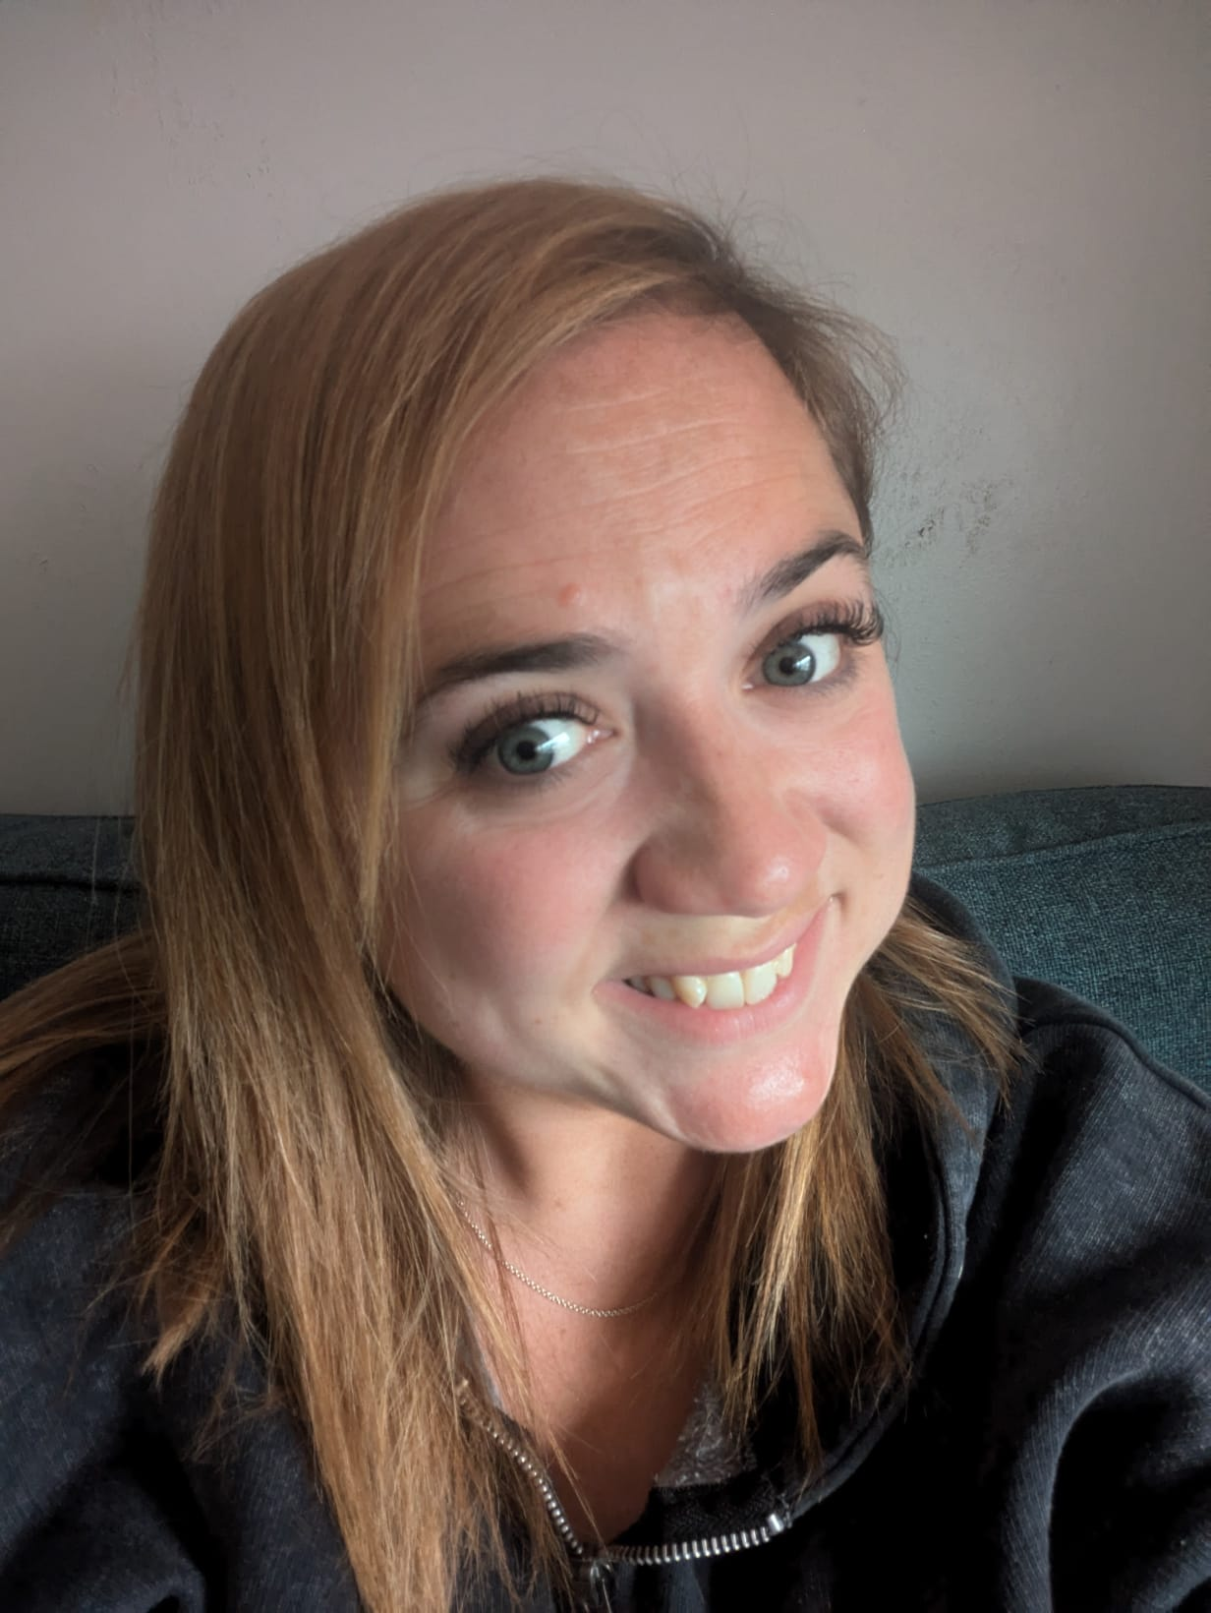
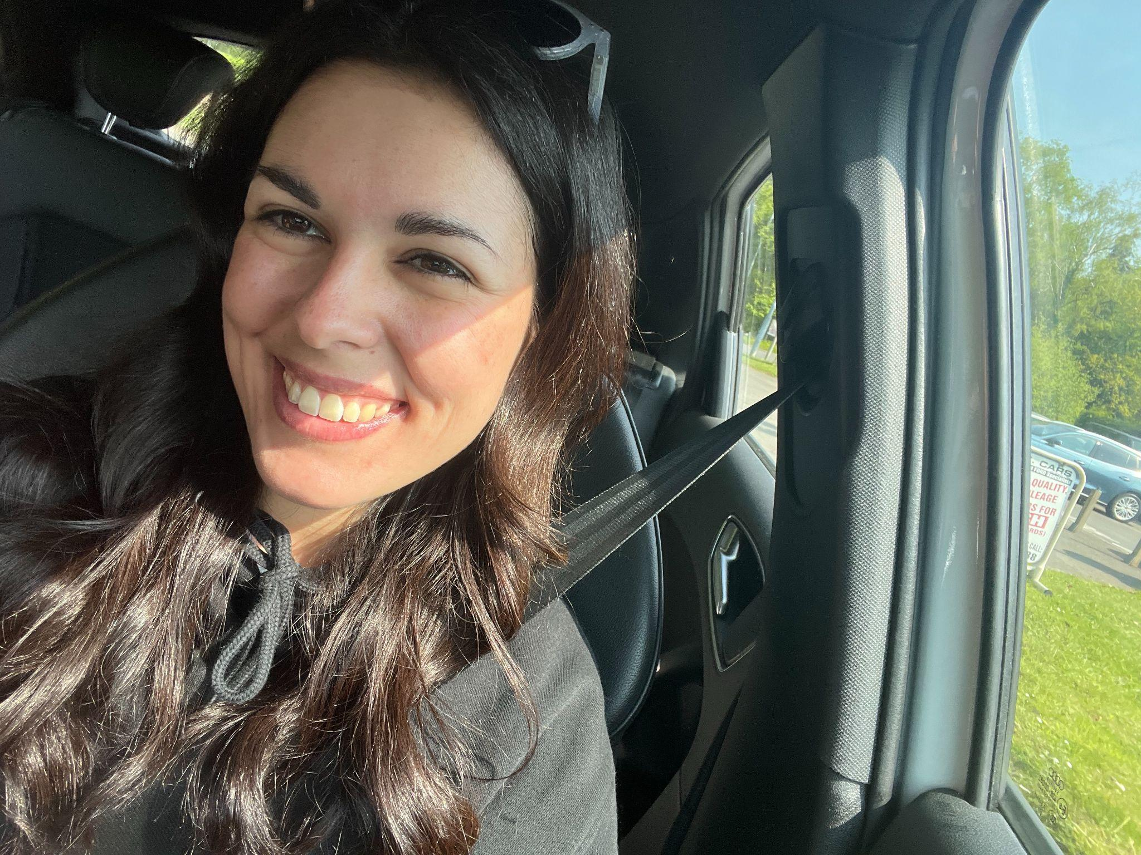
Welcome to the Year 3 Overview Meeting!
Mrs Lane (Phoenix class teacher) and Miss Pérez (Delphinus class teacher)

Slide 2
Useful information
PE: Wednesday (outdoors) and Friday (inside). You are required to wear your P.E kits to school on both of these days. PE kits should consist of trainers, not plimsoles) Earrings will need to be taken out for every PE session, this is for safety reasons.
Homework is set on Thursday and to be returned the following Tuesday. This will include spellings and topic home learning.

Slide 3
Uniform
Choice of:
Grey trousers/grey shorts/navy pinafore/navy skirt
Light blue shirt (long or short sleeved)
St Dunstan’s tie
In the summer term, a sky-blue gingham dress may be worn Navy blue V-neck sweater or cardigan, branded or unbranded
Grey socks with trousers/shorts
White, navy socks or navy tights with pinafore/skirt/summer dress
Sensible black or navy shoes
Plain navy raincoat (Optional branded navy school waterproof fleeces are available whilst stocks last)

Slide 4
Uniform
PE:
Branded (St Dunstan’s) or unbranded blue polo shirt and navy shorts
Black trainers.
Navy tracksuit bottoms can be worn in cold weather.
For swimming a one-piece costume or close-fitting swimming trunks (not loose swimming shorts) should be worn.

Slide 5
JEWELLERY, HAIR AND MAKE-UP
Children are not allowed to wear personal jewellery such as rings or bracelets to school.
In pierced ears, a plain round stud may be worn but must be removed for physical activities such as PE and games (including dance, gymnastics and swimming). If studs cannot be removed from newly pierced ears, children will be asked to cover the sharp point of the stud with micro pore tape which needs to be provided from home.
We do allow children to wear watches but they remain the responsibility of the child at all times and please not the ones that have games etc within them
For safety reasons, long hair should be tied back at all times.
Only blue or dark coloured hair bands should be worn.

Slide 6
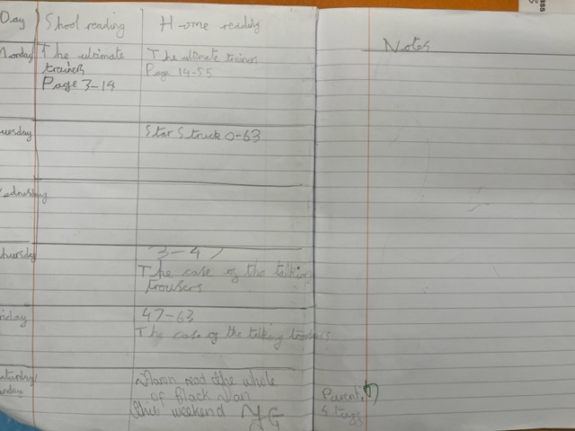
Reading
· Please ensure that your child reads for 15 minutes at home every day and writes this in their home/school book.
· Please sign the home/school book every weekend to indicate that the reading has been done every day.
· Home/school books will be checked and signed by the teacher on a Friday
· Please remind children to bring any notes written in the home/school book to the teacher’s attention or use the class email.

Slide 7
Spellings
Please continue to work on the yr ½ spelling lists as needed for your child.
Each week your child will come home with new spellings that they will be tested on each week - this is NOT something to get worried about it will just encourage them to practice!

Slide 8
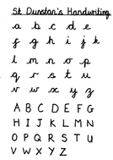
Writing
The children are expected to write in joined, legible handwriting in pencil.
Throughout the year we will be building on their previous work and covering the Year 3 curriculum.
We will continue to use the lenses on the Writing Rainbow to support the children’s writing.

Slide 9
Times Tables
Times Table Rock Stars is available for your child to use. They should use their login details which have been stuck in the back of their home/school diary.
The Year 3 Curriculum with continue to work on 2’s, 5’s and 10’s (as taught in Year 2) and we will start to cover: 3’s, 4’s and 8’s.
All children should be able to recall multiplication and division facts up to 12 x 12 by the end of year 4. Keep practising these with your child.

Slide 10
Maths Lessons
Maths lessons are based on the White Rose Scheme which supports the National Curriculum.
Maths tasks are split into three sections – fluency, reasoning and problem solving. With the addition of mastery challenges for our keen mathematicians.
The maths topics covered are: place value; addition, subtraction; multiplication and division; length and perimeter; fractions; mass and capacity: money; time; properties of shape; statistics.

Slide 11
Homework
English and maths homework will be set on Google Classroom every Thursday and must be completed by the following Tuesday. Children should spend around 20 minutes on each activity.
All homework should be completable online unless specified or sheets are given to everyone. If your child does complete homework on paper by choice then please take a photo and upload it to the assignment. Instructions for this can be found here or in the pack,
Topic homework suggestions have been given out for this half term on Google Classroom. Children are expected to complete and hand in three topic homework activities in the second to last week of each half term.

Slide 12
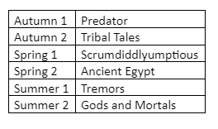
Topics
• We will have a different topic focus each half term, around which most of the children’s learning will be based:

Slide 13
Trips/events...
Spring 1 - Scrumdiddlyumptious - Chocolate workshop (TBC)
Summer 2 - Tremors - Greek Day (TBC)

Slide 14
Behaviour
· We will continue to use the schools behaviour policy with your children.
· If your child’s behaviour is causing us any concern, we will contact you.

Slide 15
Communication
You are able to contact your child’s class teacher via the class email address:
Delphinus Class: delphinus@stdunstanscheam.co.uk
Phoenix Class: phoenix@stdunstanscheam.co.uk
If your message is urgent, please phone the school office.
If your child brings a note in their home/school book, please remind them to bring it to their teacher’s attention.

Slide 16
Many thanks in advance for your support.
By working together, we hope that your child will have a happy and successful journey through Year 3.

