Slide 1
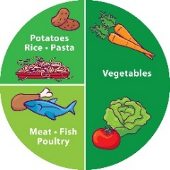
2022 Theme Day Calendar
JANUARY
Chinese New Year
JULY
Leavers Lunch
FEBURARY
International Day
SEPTEMBER
Build Your Own : Burger
MARCH
Shrove Tuesday
OCTOBER
Black History Month
APRIL
Easter
Bonfire Night
NOVEMBER
MAY
Caribbean
Christmas Lunch
JUNE
Wimbledon
DECEMBER

