Slide 1
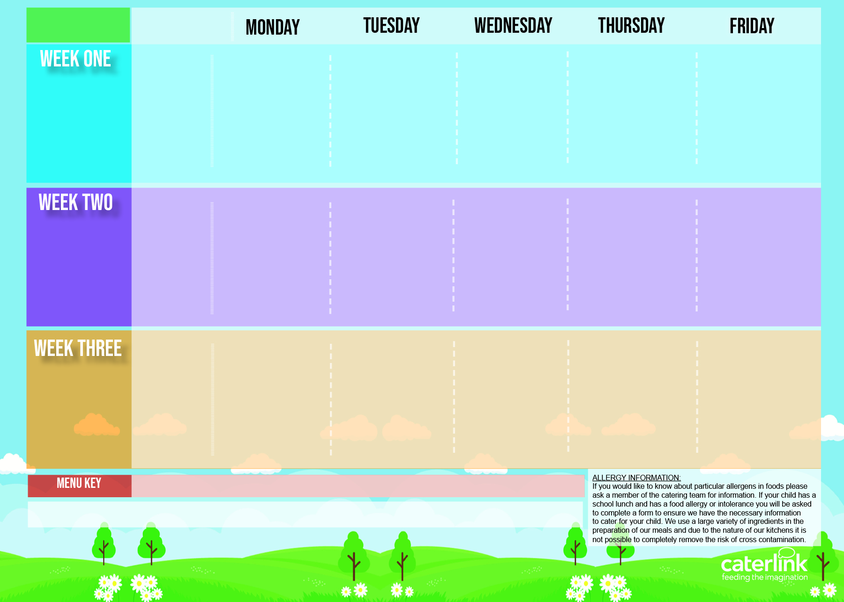
Sutton Spring/ Summer Menu 2023
Option one
Cheese & Tomato Pizza with Wedges
*Beef Lasagne with Garlic Bread
*Roast Pork, Roast
Potatoes & Gravy
*BBQ Chicken with Rice
MSC Fishfingers with Chips & Tomato Sauce
17 April
8 May
5 June
26 June
17 July
28 August
18 September
9 October
Crunchy Topped Vegetable Bake with New Potatoes
Option two
Wholemeal Vegetable Pasta Bake
NEW Sweet Potato & Spinach Flan with Roast Potatoes
BBQ Vegan Quorn with Rice
Mexican Bean Roll with Chips & Tomato Sauce
Vegetables
Sweetcorn
Roasted Tomatoes
Green Beans
Carrots
Mixed Vegetables
Cabbage
Broccoli
Peas
Peas
Baked Beans
Dessert
NEW Syrup Snap Biscuit with Yoghurt
Fruit Jelly with Peaches
Freshly Fruit Salad
Iced Vanilla Sponge with Custard
Oaty Cookie with Yoghurt
Option one
Macaroni Cheese
*Pork Sausage Hot Dog with Potato Wedges
*Roast Chicken, Roast Potatoes & Gravy
*Chicken Korma with Rice
MSC Salmon Fishfingers with Chips & Tomato Sauce
24 April
15 May
12 June
3 July
4 September
25 September
16 October
Vegan Meatball Pasta Bake
Vegan Sausage Hot Dog with Potato Wedges
Potato and Courgette Layer Bake
Vegetable Wellington with New Potatoes & Gravy
NEW BEET Burger with Chips & Tomato Sauce
Option two
Vegetables
Peas
Roasted Tomatoes
Peas
Carrots
Cabbage
Green Beans
Broccoli
Carrots
Sweetcorn
Baked Beans
Dessert
Summer Lemon Cake
NEW Cornflake Tart
Fruit Jelly with Mandarins
Peach Crumble with Custard
Chocolate Shortbread with Yoghurt
NEW Chinese Vegetable Noodles
*Spaghetti Bolognaise
*Roast Chicken, Roast Potatoes & Gravy
Yamas!
NEW *Greek Chicken Pita with Seasoned Wedges
or
NEW Spinach & Cheese Whirl with Seasoned Wedges
MSC Fishfingers with Chips & Tomato Sauce
Option one
1 May
22 May
19 June
10 July
11 September
2 October
Lentil & Sweet Potato Curry with Rice
Vegan Spaghetti Bolognaise
Vegan Quorn with Stuffing, Roast Potatoes & Gravy
Cheese & Red Pepper Frittata with Chips & Tomato Sauce
Option two
Vegetables
Carrots
Green Beans
Broccoli
Sweetcorn
Cauliflower
Carrots
Roasted Peppers
Green Beans
Peas
Baked Beans
Dessert
Peaches with Ice Cream
Carrot & Courgette Cake
Fresh Fruit Salad
Vanilla Shortbread with Yoghurt
Chocolate Sponge with Chocolate Sauce
Added Plant Power
Wholemeal
Vegan
* Halal Alternative Available
Allergy Information
If your child has an allergy or intolerance please contact the School Office. You will be asked to complete the Caterlink special diets allergy form and provide NHS medical evidence of the allergies or intolerances before your child can receive a school meal. We use a large variety of ingredients in the preparation of our meals and due to the nature of our kitchens it is not possible to completely remove the risk of cross contamination.
Available Daily:
- Jacket Potatoes with a choice of fillings (where advertised), freshly baked bread, organic yogurt, a selection of fruit and salads.

