Slide 1


Phonics and Early Reading at St Dunstan’s
Welcome
Part 1 – Little Wandle Programme at St Dunstan’s
Part 2 – How we teach phonics
Part 3 – How we teach reading
Part 4 - Questions

Slide 2
Phonics
Identifying sounds in spoken words.
Recognising the common spellings of each phoneme.
Blending phonemes into words for reading.
Segmenting words into phonemes for spelling.
Although there are 26 letters in the English alphabet, there are 44 speech sounds.

Slide 3

Some Definitions
A Phoneme
This is the smallest unit of sound in a word.
How many phonemes can you hear in cat?

Slide 4
Phonemes are represented by graphemes.
A grapheme can consist of 1, 2 or more letters.
A phoneme can be represented/spelled in more than one way (cat, kennel, choir))
The same grapheme may represent more than one phoneme ( me, met)

Slide 5

A phoneme you hear
A grapheme you see
A word always has the same number of phonemes and graphemes!

Slide 6
Blending – a key skill for reading
Recognising the letter sounds in a written word, for example:
c-u-p
and then merging or ‘blending’ them in the order in which they are written to pronounce the word ‘cup’.

Slide 7
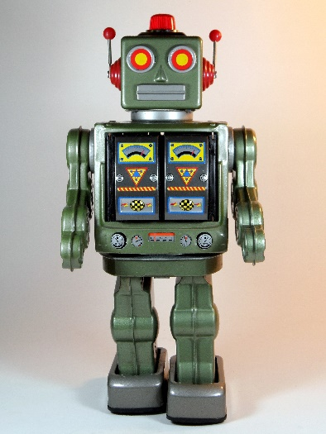
Segmenting – a key skill for writing
‘Chopping up’ the word to spell it out
The opposite of blending
Identifying the individual sounds in a spoken word (e.g. h-i-m , s-t-or-k) and writing down letters for each sound (phoneme) to form the word.

Slide 8
Little Wandle
Following government guidance last year, we have bought a new Phonics programme, Little Wandle Letters and Sounds revised. This programme has been validated and approved by the government.
Little Wandle Letters and Sounds Revised draws on the latest research into how children learn best; how to ensure learning stays in children’s long term memory and how best to enable children to apply their learning to become highly competent readers.
We now have one programme for the whole school :
  We have a systematic approach to ensure consistency for the children
  We are using the same resources, mnemonics and key words to teach the children
  We are using decodable books
  We are ensuring that there is high quality teaching of phonics across the school.
Notes:
Government changes mean a change (for the better) in how we teach phonics and reading at school - make sure there is consistency throughout
Early reading is the stage where children are learning to become fluent readers through the use of phonics. New Dfe guidance -/ government / validated

Slide 9
Little Wandle Letters and Sounds
The Little Wandle Letters and Sounds scheme is divided into five phases, with each phase building on the skills and knowledge of previous learning.
Reception – Phase 2 & 3
Year 1 – Phase 4 (consolidation) & 5
Children have time to practise and rapidly expand their ability to read and spell words.
They are also taught to read and spell ‘tricky words’, which are words with spellings that are unusual.
https://www.littlewandlelettersandsounds.org.uk/resources/for-parents/

Slide 10
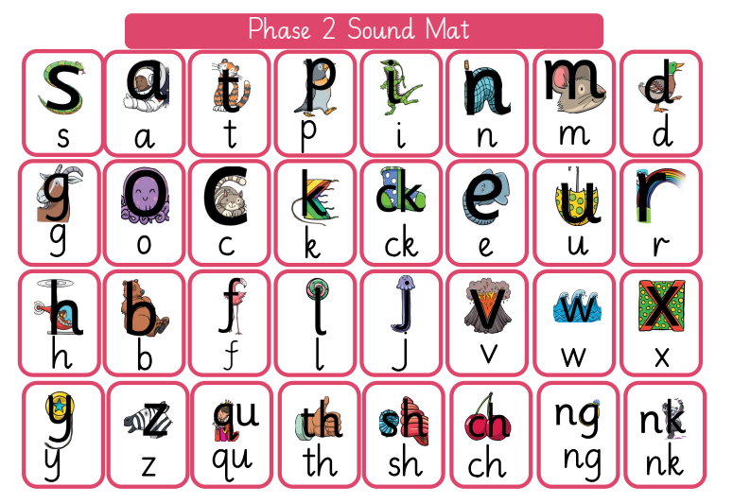
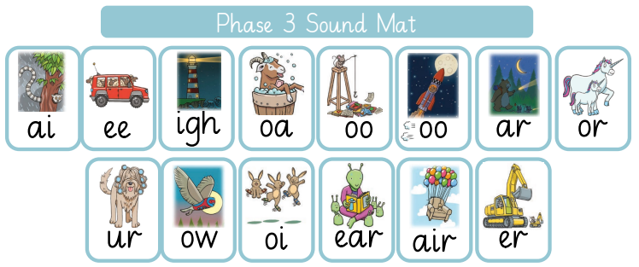
Reception
In Reception, we teach phonics building from 10- minute lessons, with additional daily oral blending games, to the full length lesson as soon as the children are ready.
Every Friday, we review the week to consolidate learning and ensure that the new sounds taught are retained.

Slide 11
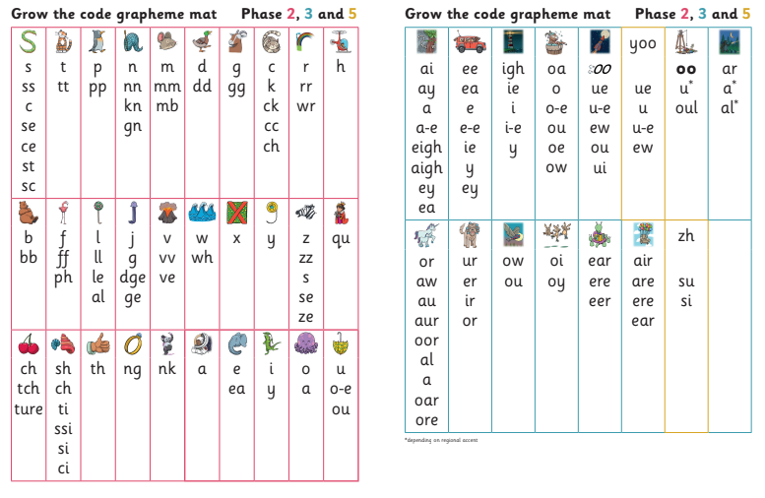
Year 1
In Year 1 we review the sounds taught in Reception and move onto new graphemes, alternative pronunciations and consonants blends.
There is a similar pattern with structure of our lessons from reception to Year 1/2.
Notes:
New programme – over lap and links with the old letter and sounds

Slide 12
Year 2
In Year 2 this year, we have identified a need to continue teaching phonics everyday for all the children.
However, we are also teaching the spelling rules for Year 2 every afternoon using the ‘no nonsense programme’ weekly. The spellings rules are shared via google classroom every week.
Some children have been identified as needing additional support and these children are using the Little Wandle programme with the 3 additional reads a week.
Notes:
New programme – over lap and links with the old letter and sounds

Slide 13
A typical phonics lesson
In each year group, phonic lessons follow the same format:
  Revise: The children will revise previous learning.
  Teach: New phonemes or high frequency or tricky words will be taught.
  Practise: The children will practise the new learning by reading and/or writing the words.
  Apply: The children will apply their new learning by reading or writing sentences. In reception we practise writing tricky words and words that feature our new phoneme.
Notes:
From Foundation Stage 2 to Year 3 all phonics lessons follow this format

Slide 14
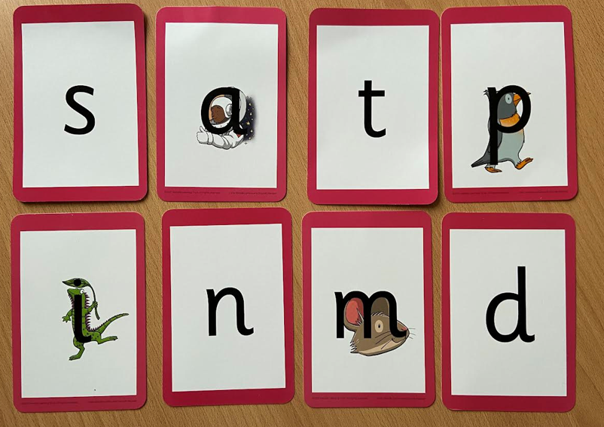
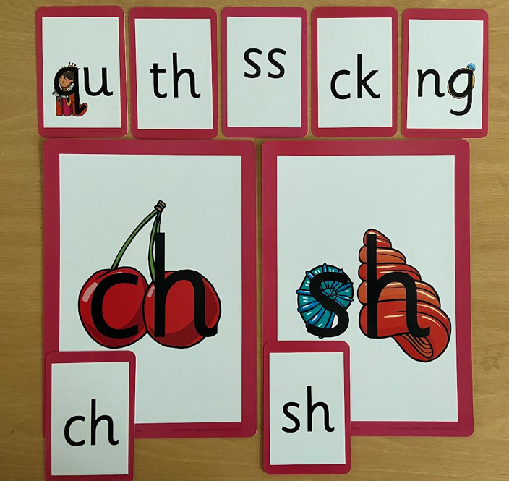
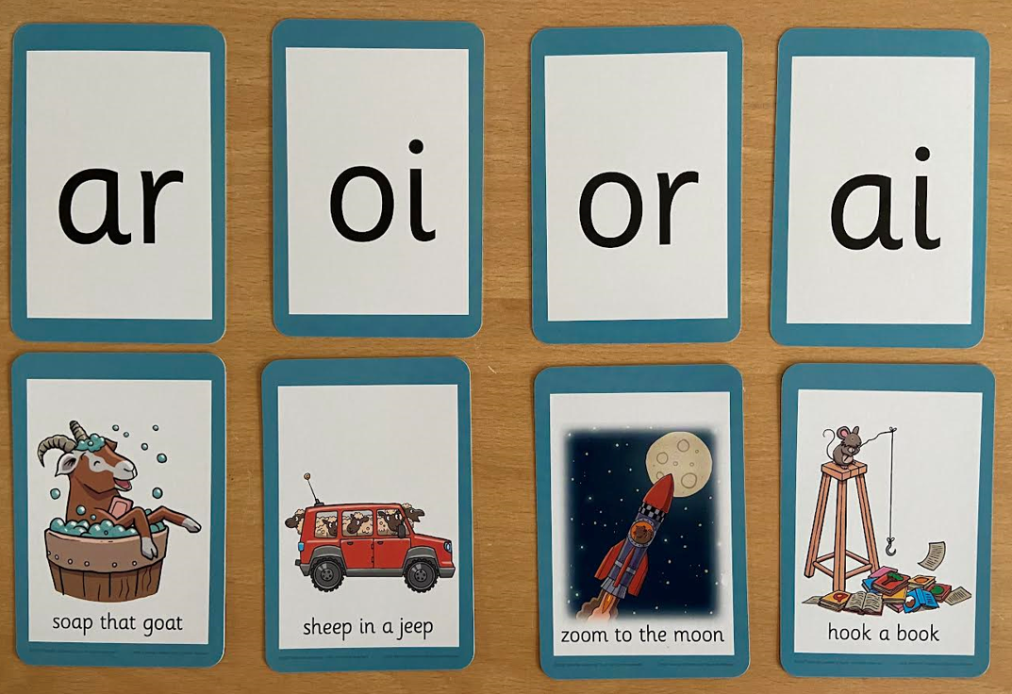
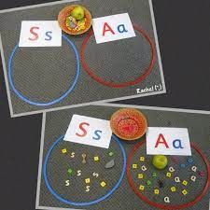
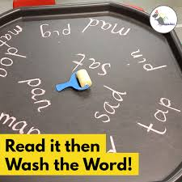
Engaging resources
Repeated practice
Revisit previously taught sounds at start of each lesson
Notes:
Attractive cards / remember sounds / phrases for diagraphs for children to remember /opportunities to practice phonics skills in play

Slide 15
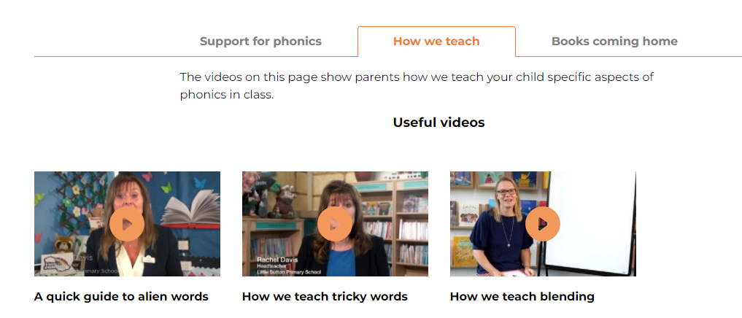
How we teach blending
https://www.littlewandlelettersandsounds.org.uk/resources/for-parents/
Notes:
Other useful videos on the website

Slide 16
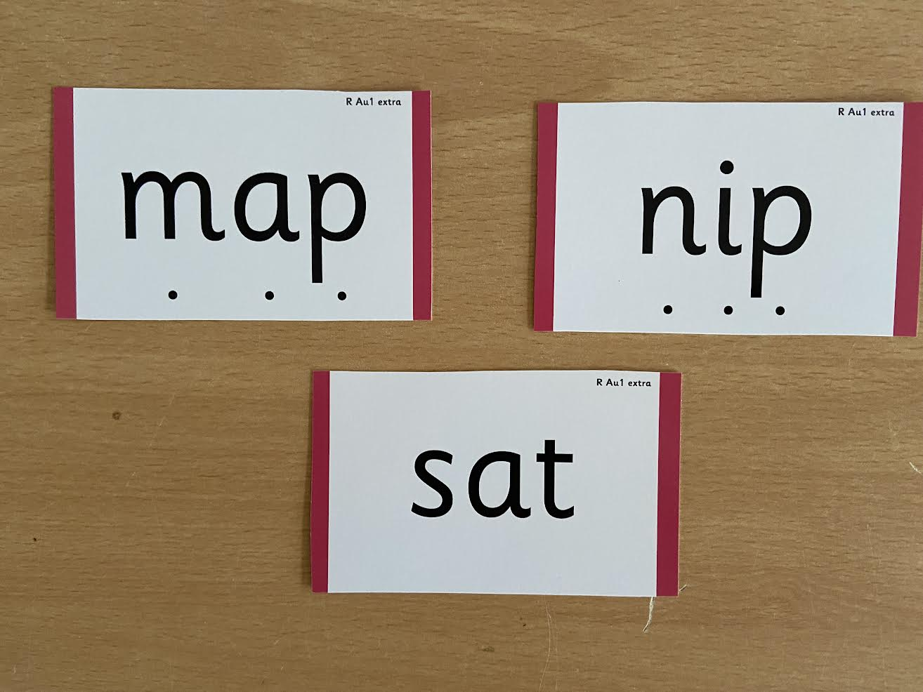
Notes:
During phonics lessons we use Sound buttons so we can sound talk and blend to read

Slide 17
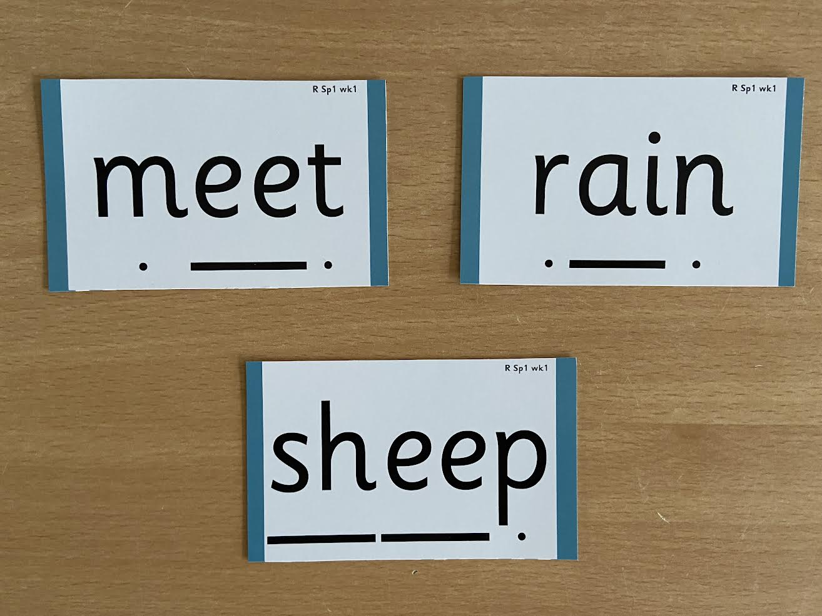
Notes:
Digraphs have a zip to sound talk and blend

Slide 18
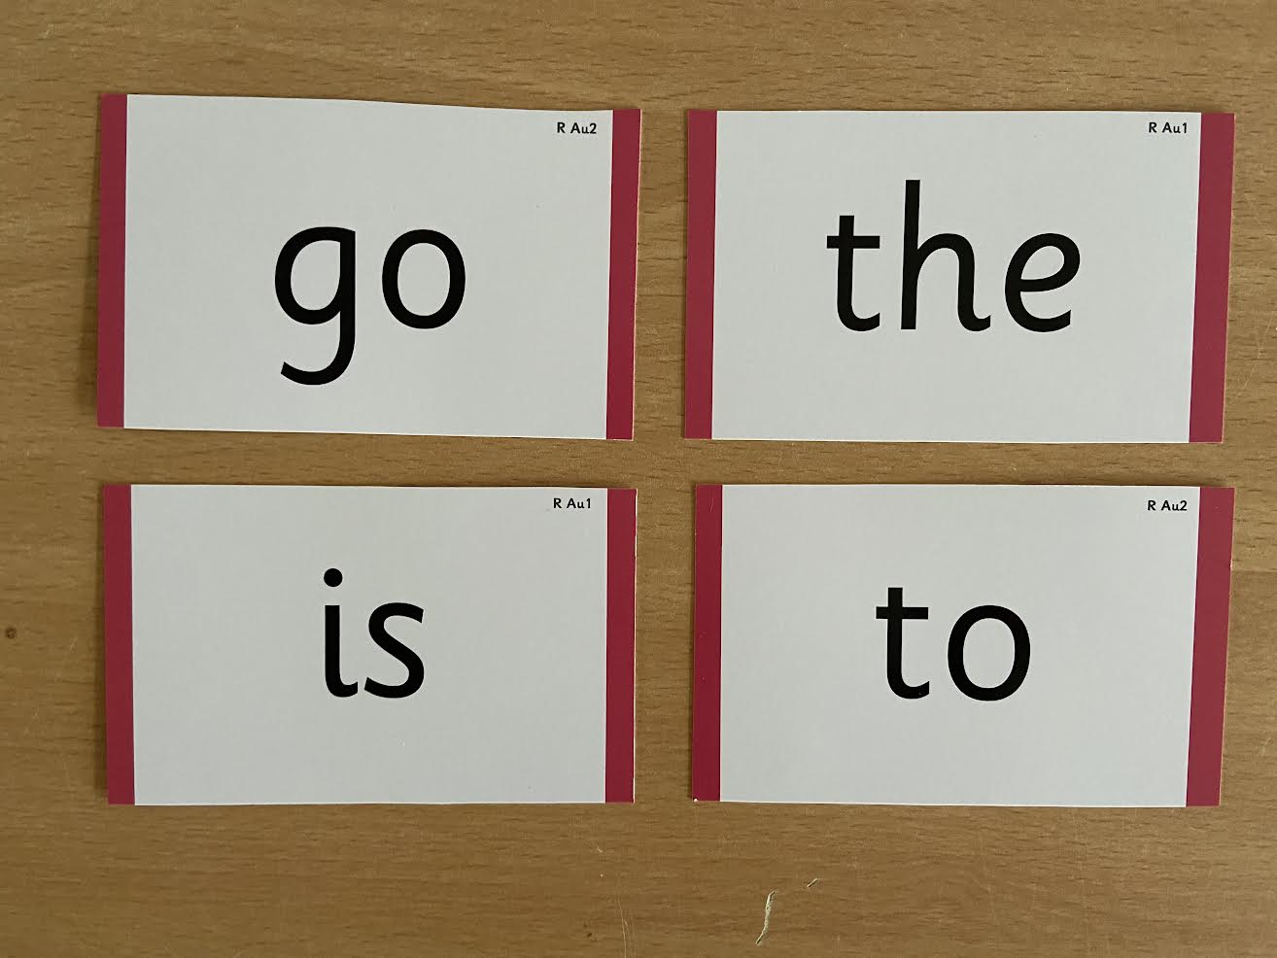
Notes:
Words that do not follow the rules and cannot be decoded – tricky words/ exception words
Chn are taught what part of the word is tricky

Slide 19
Assessment
Informal assessment during our daily phonics and within the three weekly reads
Formal assessments every 6 weeks
The impact of this
Children are quickly identified for keep up sessions
We build an accurate picture to inform for the following 6 weeks
Reading books are matched to the correct level
Notes:
Use our assessments – keep up sessions are set up for those who need it. Half termly assessments and review week

Slide 20
Keep-up sessions
Any child who needs additional practice in recognition of graphemes or blending.
Keep-up sessions are in smaller steps with more repetition, so that every child secures their learning.

Slide 21

Reading
The three weekly reading sessions are small groups of up to six children
Books are matched to the children’s secure phonic knowledge using the Little Wandle Letters and Sounds Revised assessments and book matching grids.
Children are monitored by the class teacher, who rotates and works with each group.
Each reading practice session has a clear focus. The reading practice sessions have been designed to focus on three key reading skills:
1.Decoding
2. Prosody: teaching children to read with intonation and expression
3. Comprehension: teaching children to understand the text.
In Reception, these sessions start approximately in Week 4. Children who are not yet decoding have daily additional blending practice in small groups or 1:1, so that they quickly learn to blend and can begin to read books.
From Year two onwards, we continue to support reading in this way through targeted intervention for any children who still need to practise reading with decodable books.

Slide 22
Home reading
Supporting your child with reading
Although your child will be taught to read at school, you can have a huge impact on their reading journey by continuing their practice at home.
There are two types of reading books that your child may bring home:
A reading practice book. This will be at the correct phonic stage for your child. They should be able to read this fluently and independently.
A sharing book. Your child is not going to be able to read this on their own. This book is for you both to read and enjoy together.
Reading practice book
This decodable reading practice book is taken home to ensure success is shared with the family. Listen to them read and give them lots of praise –celebrate their success.
It has been carefully matched to your child’s current reading level. If your child is reading it with little help, please don’t worry that’s it’s too easy –your child needs to develop fluency and confidence in reading.
When children take their book home to read they should be 95% fluent at the first reading session. Re-reading a book they have had before helps develop fluency and comprehension.
Sharing book
In order to encourage your child to become a lifelong reader, it is important that they learn to read for pleasure. The sharing book is a book they have chosen for you to enjoy together.
Please remember that you shouldn’t expect your child to read this alone. Read it to or with them. Discuss the pictures, enjoy the story, predict what might happen next, use different voices for the characters, explore the facts in a non-fiction book. The main thing is that you have fun!
Notes:
We use a wealth of resources to engage our families and share information about phonics, the benefits of sharing books, how children learn to blend and other aspects of our provision, both online and through workshops.

Slide 23

Reading
We want children to
love reading
Learning to read should be
a positive experience
Reading should be
enjoyable
We want children to read
for pleasure
Reading underpins children’s access to the curriculum
and clearly impacts on their achievement
Notes:
We all know how important learning to read is and the impact it has on a childs success - it has to be a positive experience
Whats the reality? Reluctant to read because they find it hard
Frustration stress tears – that’s just the parents
Important to look at the big long term picture

Slide 24
Evidence for pleasure for reading
Reading also offers important emotional benefits, enabling pupils, through listening to and talking about stories, to talk about their ideas and feelings and to lose themselves in books
Parents/carers who engage their children in books prepare them to become committed and enthusiastic readers
They can transform their attitudes to reading.
Their children learn to focus and share the enjoyment of the story.
They learn how stories start and finish, and how a plot unravels and is resolved; they learn that books can transport them elsewhere.
Researchers in the United States who had looked at the impact of parents reading with their children quoted the following figures in a news release about their findings: Here are how many words children would have heard by the time they were 5 years old:
Never read to, 4,662 words; 1–2 times per week, 63,570 words; 3–5 times per week, 169,520 words; daily, 296,660 words; and five books a day, 1,483,300 words.
As far back as the 1970s, evidence was emerging suggesting that ‘reading for pleasure had a powerful influence on children’s development.

Slide 25
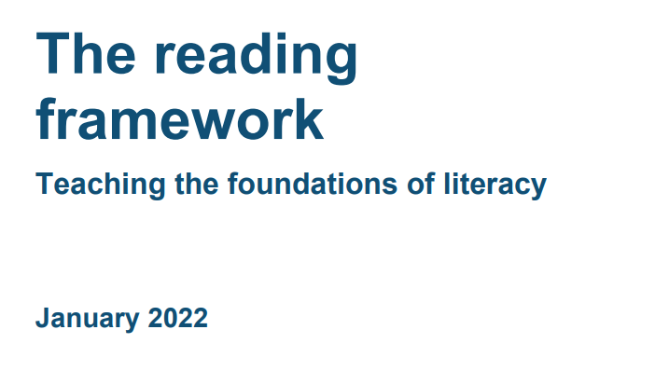
How to encourage reading for pleasure at home
Set a good example – let your child see you read and that you value books
Talk about reading, share your views about books you have read
Talk about books that you have liked and didn’t like and why
Send the message that reading is fun and it is ok not to like a book
https://www.gov.uk/government/publications/10-top-tips-to-encourage-children-to-read/10-top-tips-to-encourage-children-to-read

Slide 26
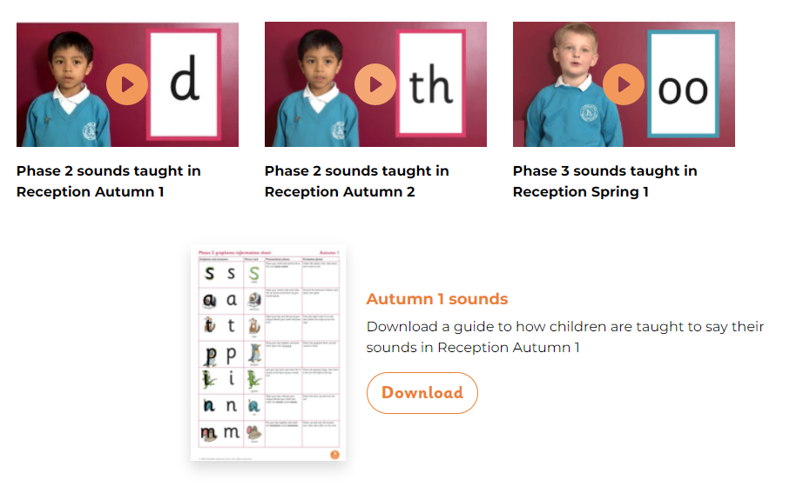
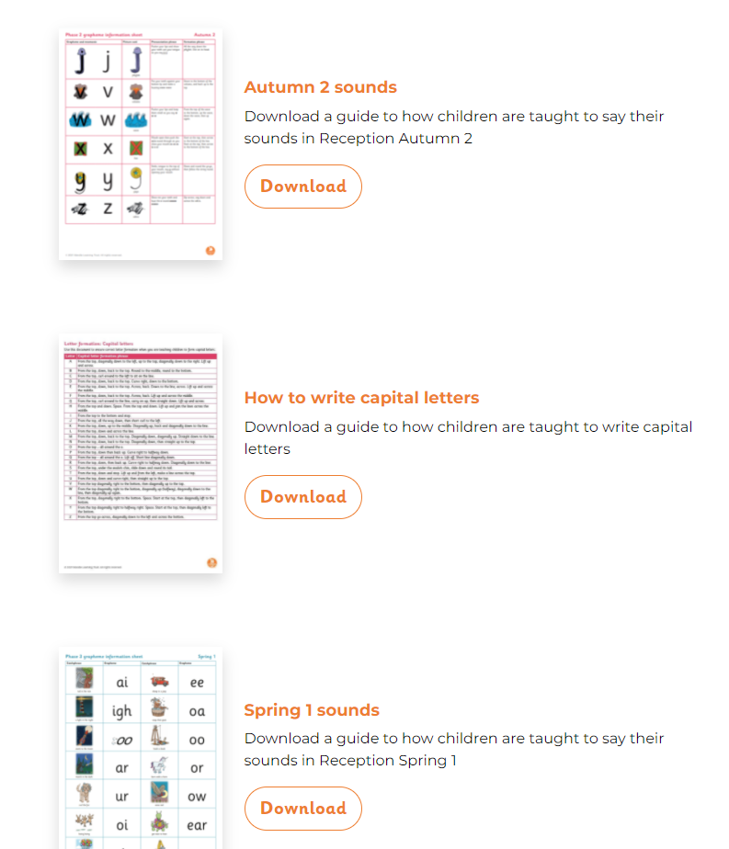
How else can you help at home?
Review graphemes and tricky words for the week.
Look out for these in books you are reading for pleasure.
Re-read the reading practice book at home and celebrate your child’s success.
https://www.littlewandlelettersandsounds.org.uk/resources/for-parents/

Slide 27
Thank you for joining us.
Questions?

