Slide 1
Teach reading: change lives
Parent workshop: Phonics and early reading

Slide 2
A love of reading is the biggest indicator of future academic success.
OECD (The Organisation for Economic Co-operation and Development)

Slide 3

Phonics

Slide 4
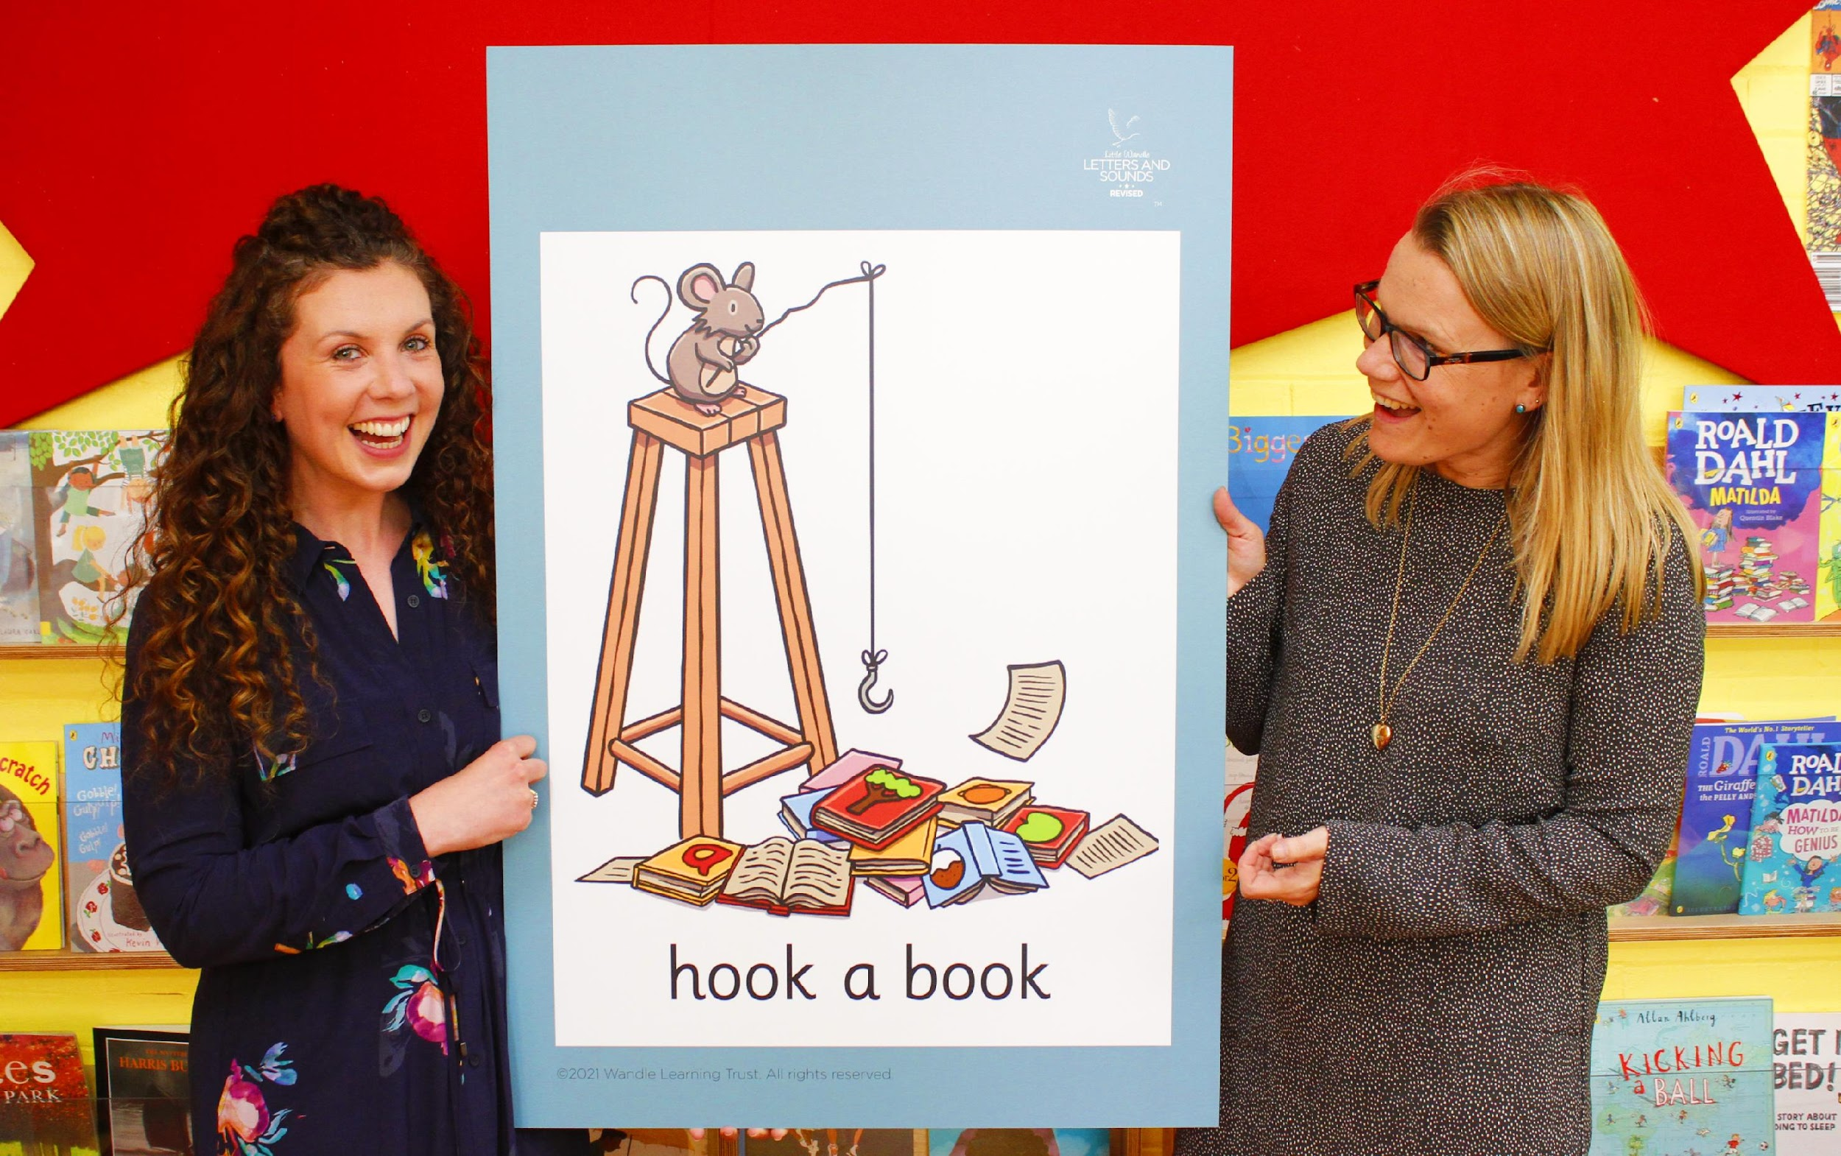
Little Wandle Letters and Sounds Revised
Our school has chosen
Little Wandle Letters and Sounds Revised as our systematic, synthetic phonics (SSP) programme to teach early reading and spelling.

Slide 5
Phonics is:
making connections between the sounds of our spoken words and the letters that are used to write them down.

Slide 6
Terminology
Phoneme
Split vowel digraph
Grapheme
Blend
Digraph
Segment
Trigraph

Slide 7
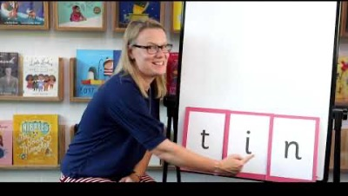
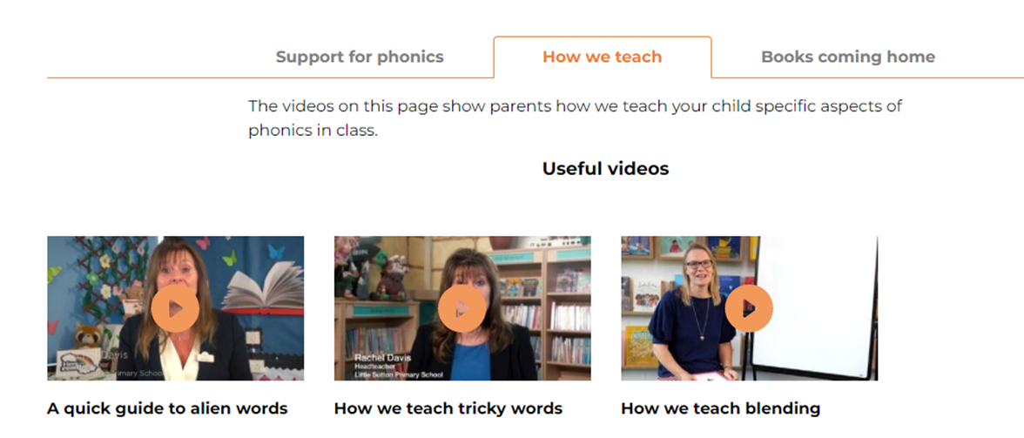
Blending to read words
https://www.littlewandlelettersandsounds.org.uk/resources/for-parents/

Slide 8
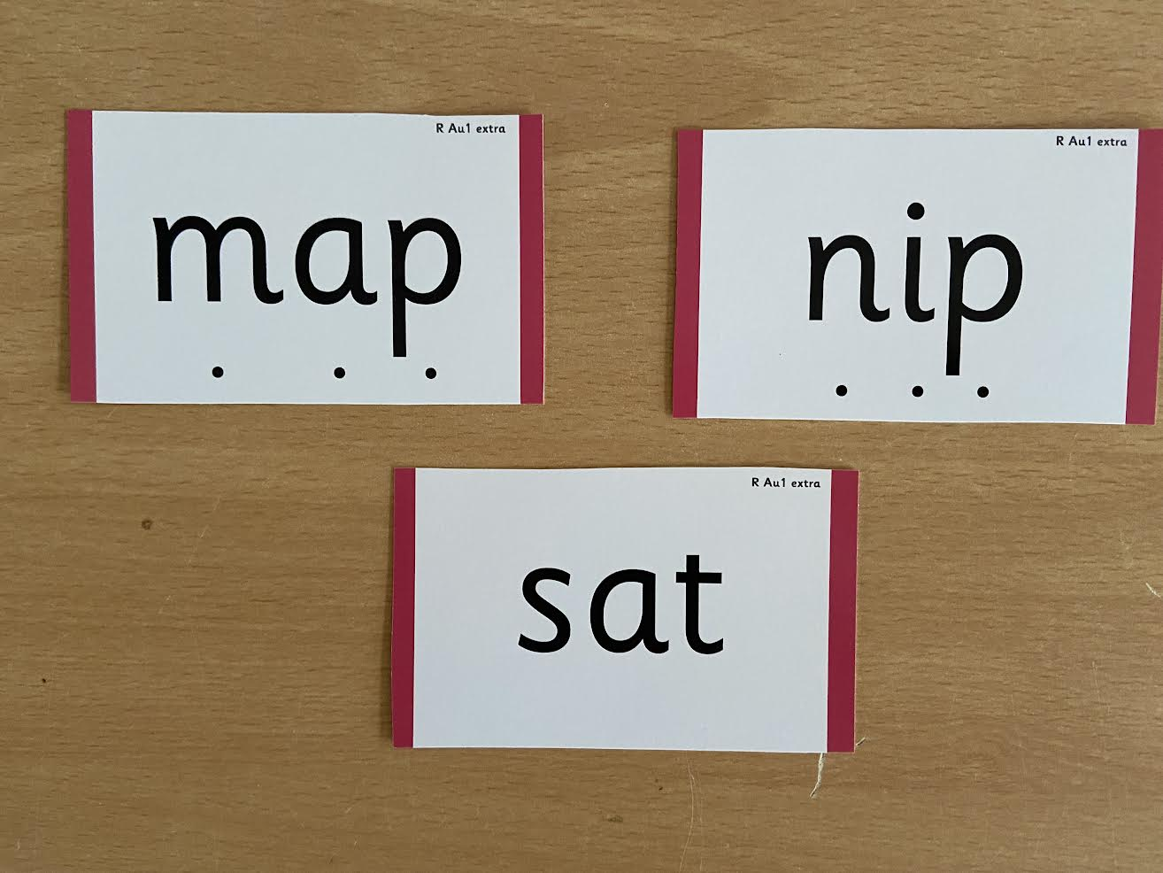

Slide 9
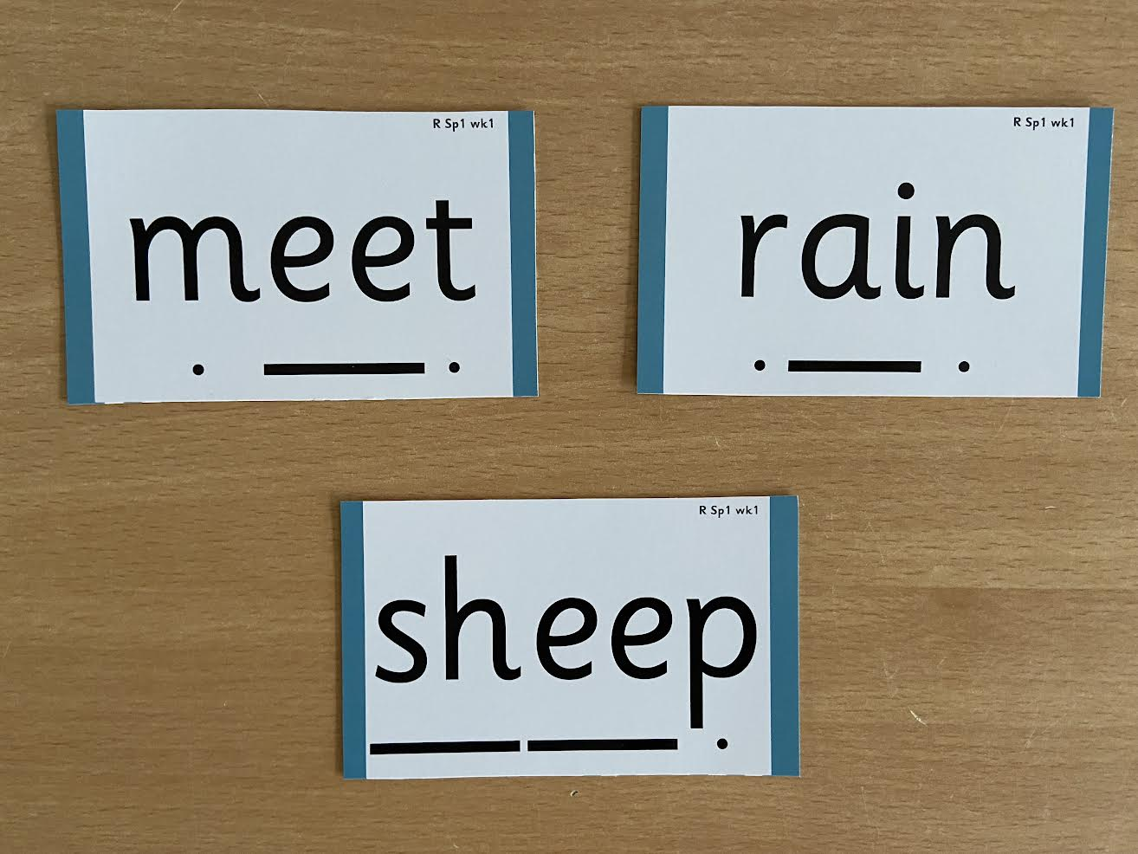

Slide 10
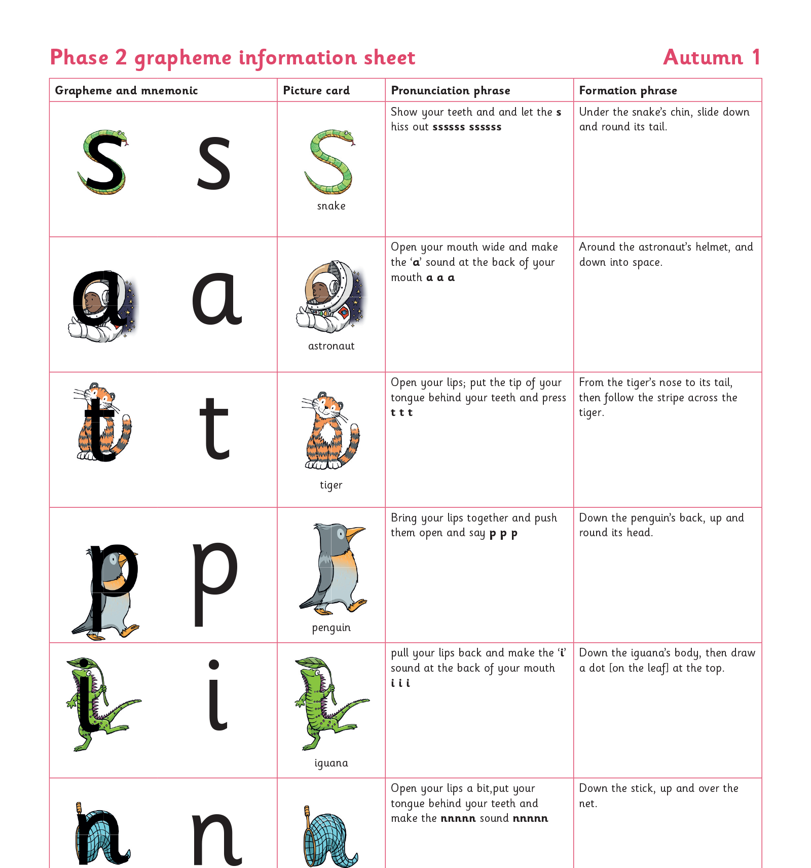
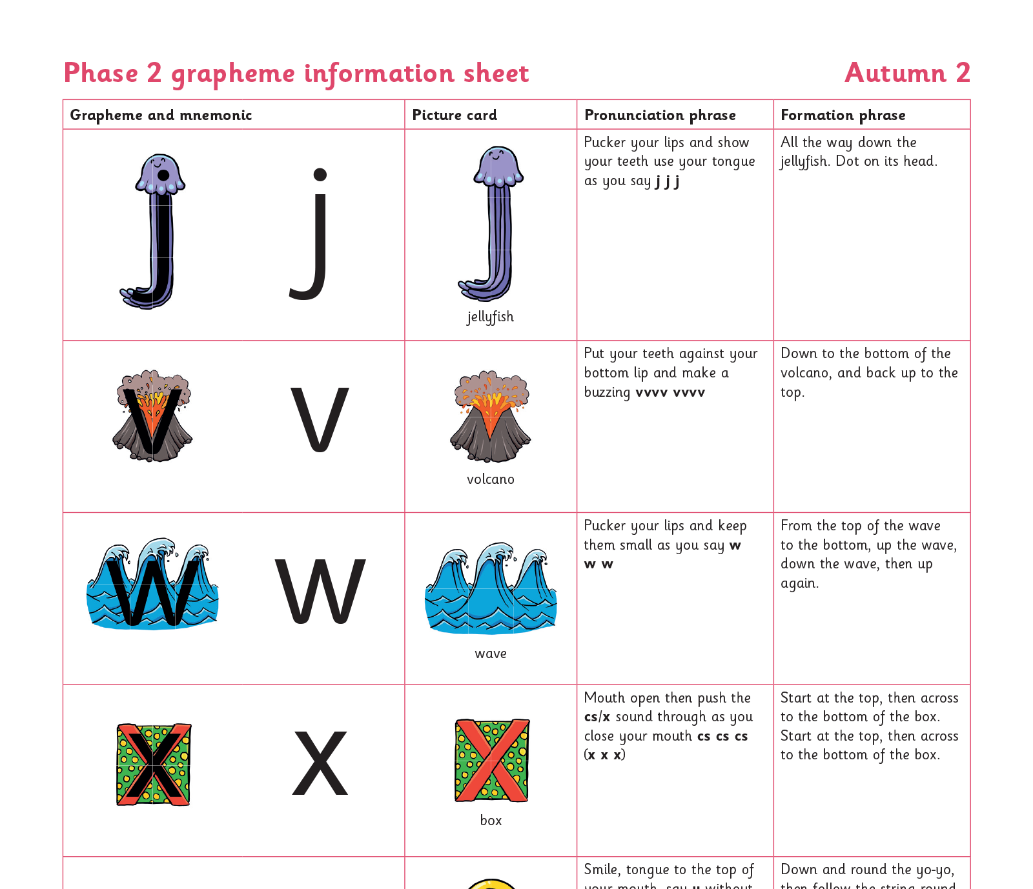
Teaching order : Weekly Lessons

Slide 11
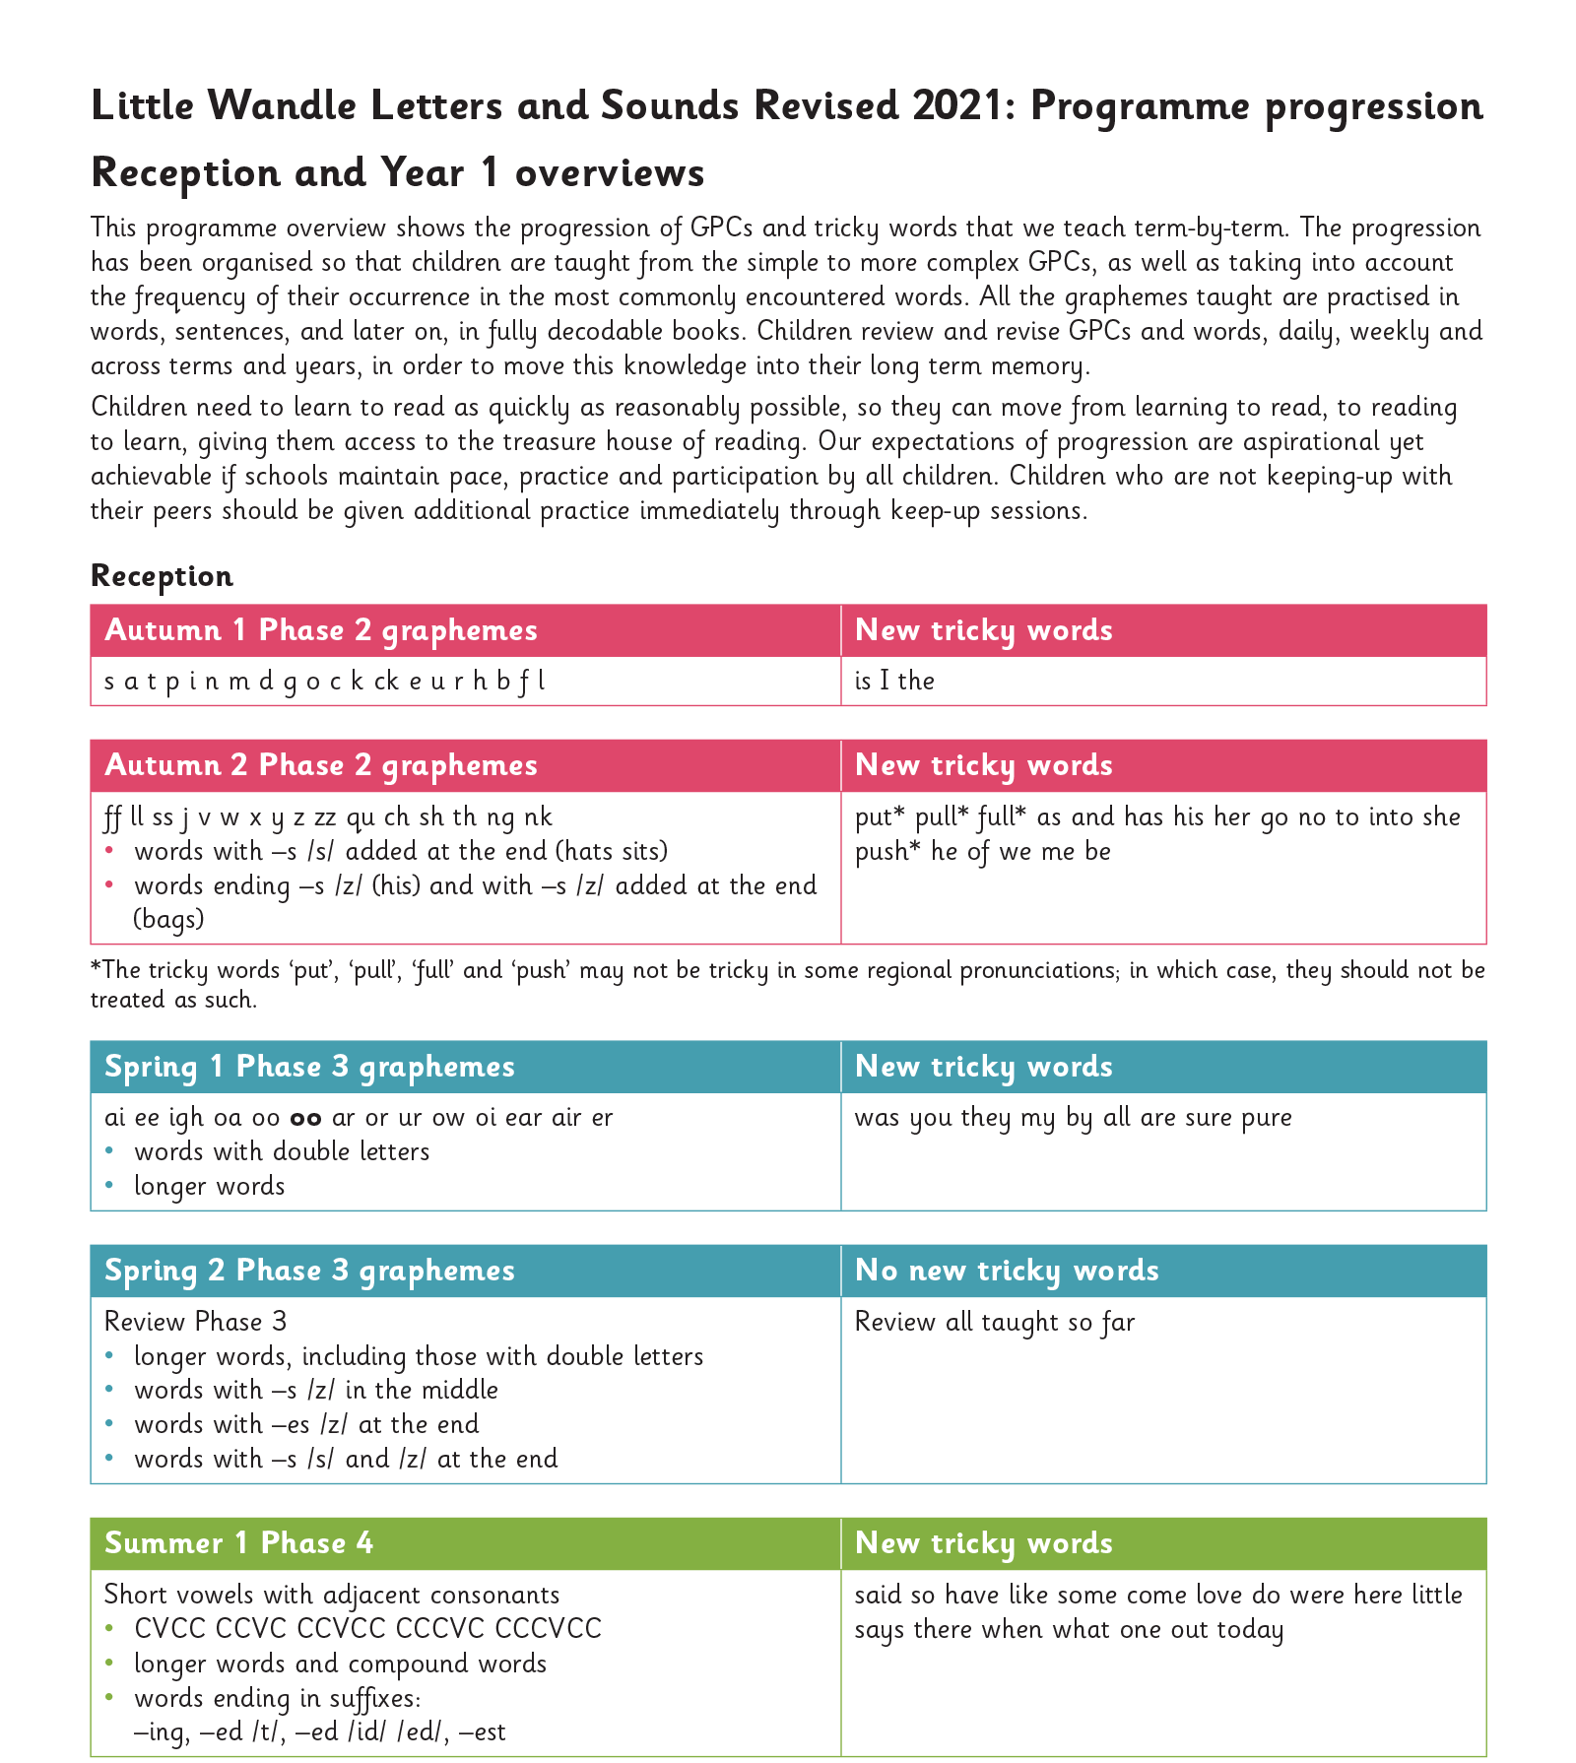
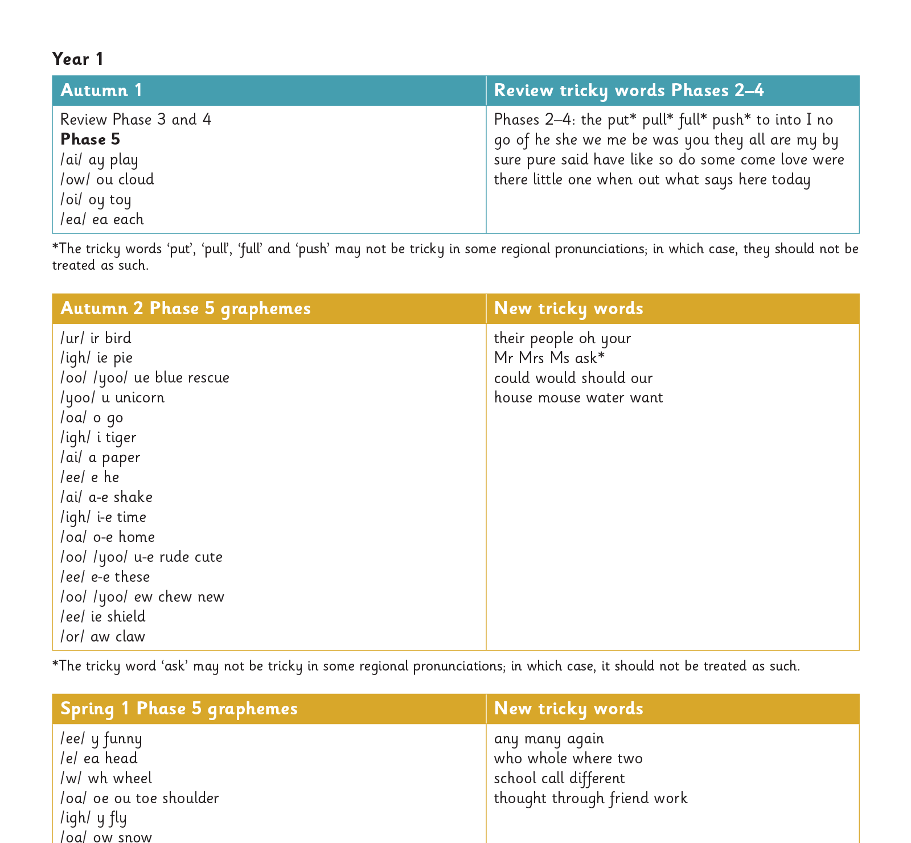
Gradually your child learns the entire alphabetic code:

Slide 12
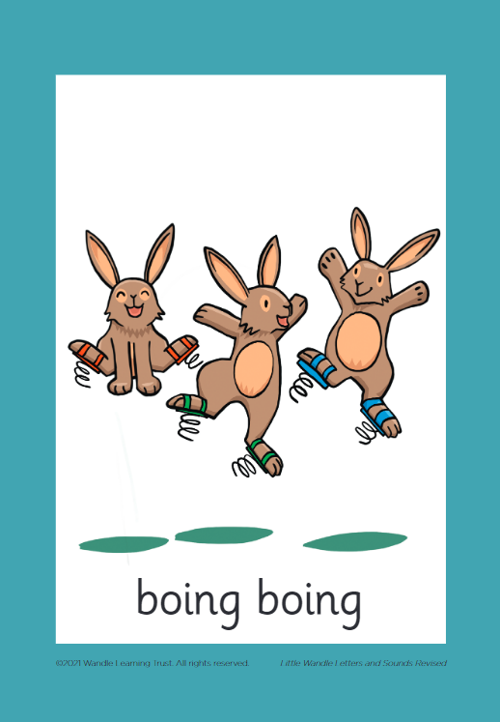



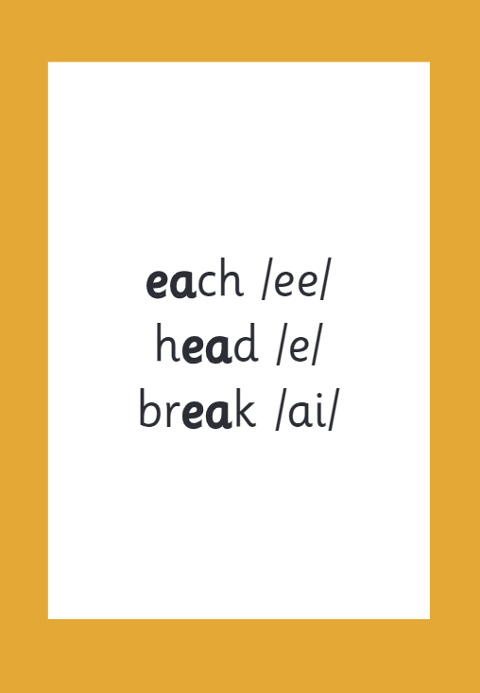

How we make learning stick

Slide 13
Reading and spelling

Slide 14
Reading and spelling

Slide 15
And all the different ways to write the phoneme sh:
shell
chef
special
caption
mansion
passion

Slide 16
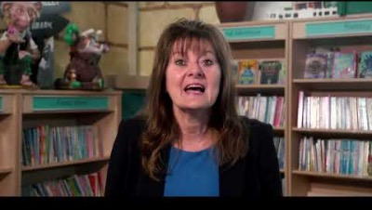
Tricky words

Slide 17

Spelling
Say the word.
Segment the sounds.
Count the sounds.
Write them down.

Slide 18

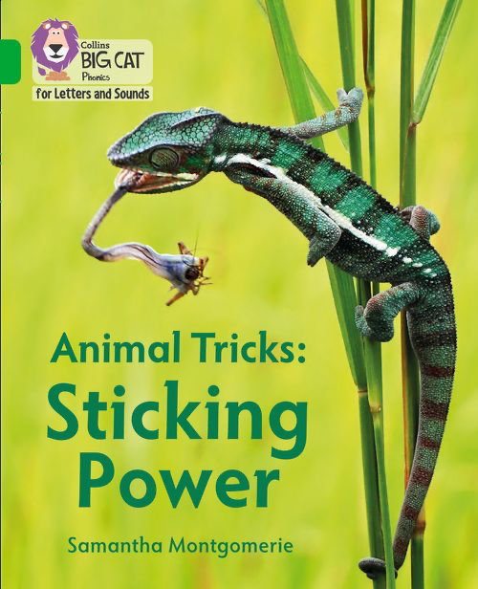
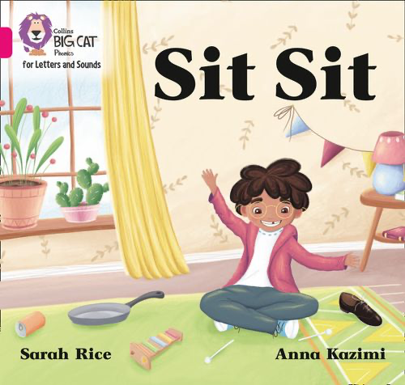
How do we teach reading in books?
Reading practice sessions are:
timetabled three times a week
taught by a trained teacher/teaching assistant
taught in small groups.

Slide 19
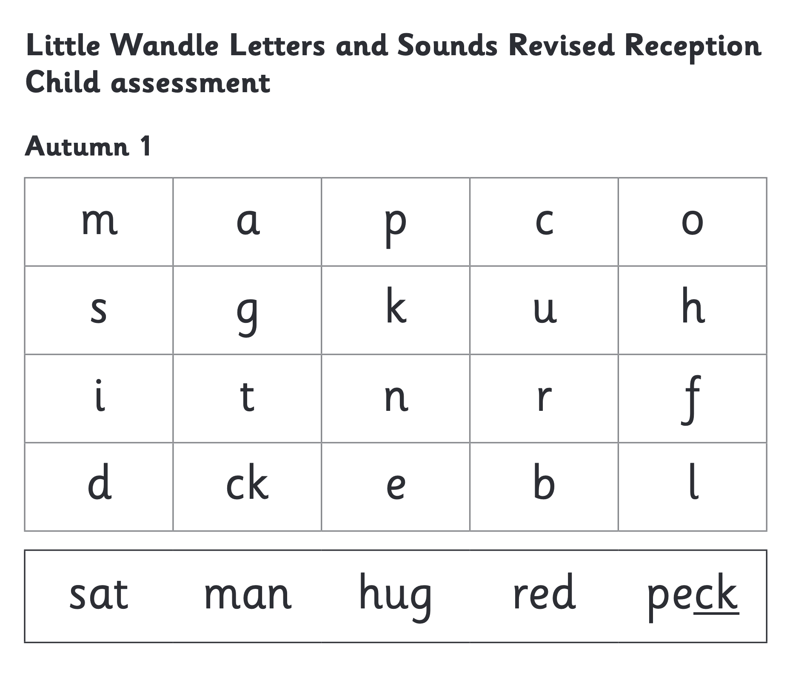



We use assessment to match your child the right level of book

Slide 20
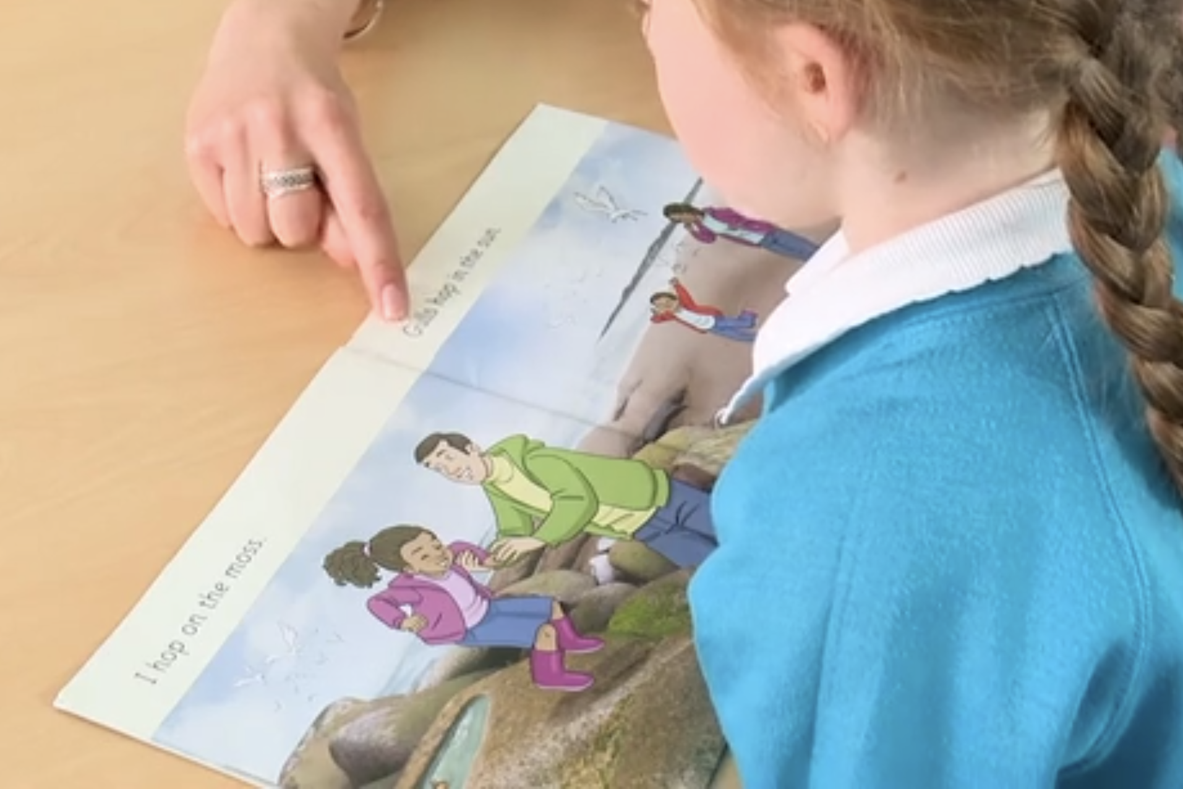
Reading a book at the right level
This means that your child should:
Know all the sounds and tricky words in their phonics book well
When they are more confident they should read many of the words by silent blending (in their head) – their reading will be automatic
They should then start to use expression and notice different punctuation in the book

Slide 21
Reading at home

Slide 22

The most important thing you can do is read with your child
Reading a book and chatting had a positive impact a year later on children’s ability to…
understand words and sentences
use a wide range of vocabulary
develop listening comprehension skills.
The amount of books children were exposed to by age 6 was a positive predictor of their reading ability two years later.
Parental involvement in the development of children’s reading skills: A five-year longitudinal study (2002) Senechal, M. and Lefvre, J

Slide 23


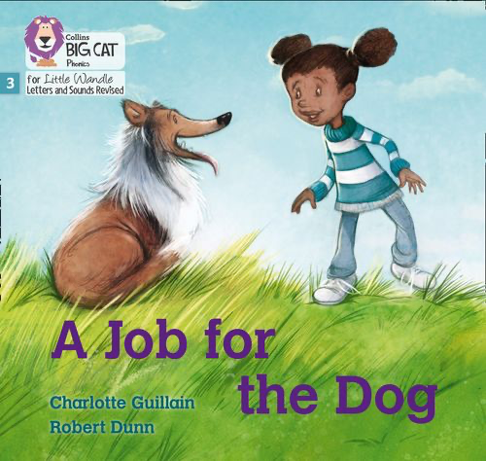


Books going home

Slide 24
Listening to your child read their phonics book
Your child should be able to read their book without your help.
If they can’t read a word encourage them to use the sounds they know and blend the word.
If they still need help, read it to them.
Talk about the book and celebrate their success. There are additional questions in the book if you want to use them.

Slide 25
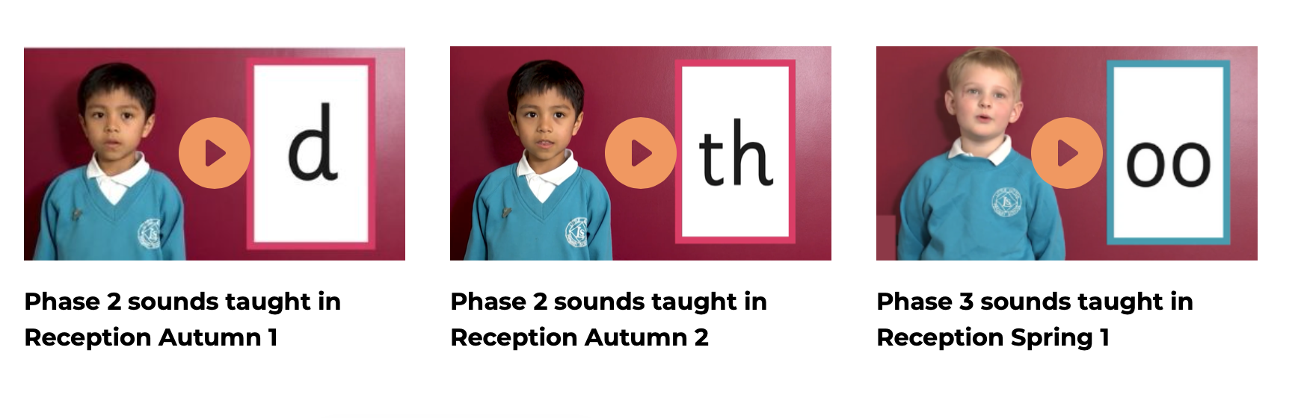
Supporting your child with phonics
Notes:
https://www.littlewandlelettersandsounds.org.uk/resources/for-parents/

Slide 26

Read to your child
The shared book (library book) is for YOU to read:
Make the story sound as exciting as you can by changing your voice.
Talk with your child as much as you can:
  Introduce new and exciting language
  Encourage your child to use new vocabulary
  Make up sentences together
  Find different words to use
  Describe things you see.

Slide 27
