Slide 1
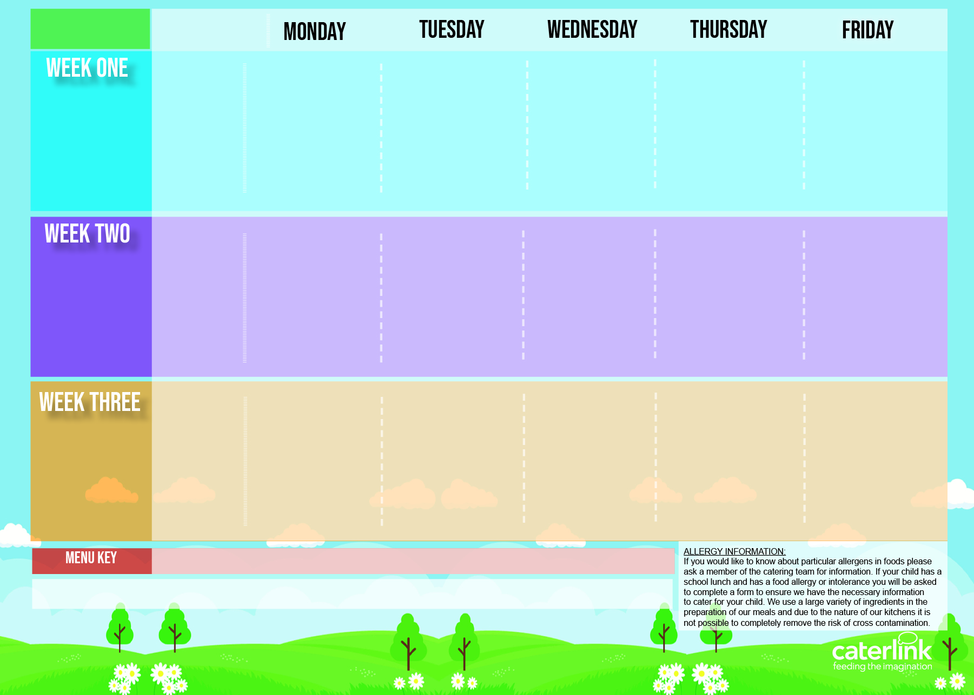
Central Autumn Winter Menu 2024 2025
Tomato & Vegetable Pasta | * Beef Burger in a Bun with Potato Wedges | * Roast Chicken with Stuffing, Roast Potatoes and Gravy Vegetable Wellington with Roast Potatoes and Gravy | * Chicken Pasta Bake with Garlic Bread | MSC Salmon Fishfingers with Chips and Tomato Sauce
Mexican Fajitas with Rice | Vegan Burger in a Bun with Potato Wedges |  | Creamy Chickpea and Coconut Curry with Rice | Cheesy Bean Pasty with Chips & Tomato Sauce
Roasted Peppers Green Beans | Sweetcorn Roasted Tomatoes | Carrots Cabbage | Broccoli Carrots | Baked Beans Peas
Blackberry and Apple Crumble with Custard | Fresh Fruit Salad | Melting Moments with Organic Yoghurt | Carrot and Courgette Cake with Custard | Chocolate and Beetroot Brownie
04/11 25/11 16/12 20/01 10/02 10/03 31/03
Classic Cheese and Tomato Pizza Vegan Sausage Roll With Potato Wedges | * Chicken Meatballs in Tomato Sauce with Pasta | * Roast Beef with Roast Potatoes and Gravy | * Chicken Tikka Masala with Rice | MSC Fishfingers with Chips and Tomato Sauce
 | Loaded Jackets | Vegan Sausage with Roast Potatoes and Gravy | Plant Balls in Tomato Sauce with Rice | Cheese and Tomato Quiche with Chips and Tomato Sauce
Broccoli Sweetcorn | Carrots Green Beans | Swede Carrots | Sweetcorn Broccoli | Baked Beans Peas
Vanilla Ice Cream with Mandarins | Marble Cake with Custard | Rice Pudding with Mixed Berries | Peach Cake with Custard | Chocolate Shortbread with Organic Yoghurt
11/11 02/12
06/01 27/01 24/02 17/03
Macaroni Cheese | * Beef Spaghetti Bolognaise Hot Pot Baked Bean Casserole | * Pork Sausage with Roast Potatoes and Gravy | * BBQ Chicken with Rice | MSC Fish in Batter with Chips and Tomato Sauce
Mild Mexican Chilli with Rice |  | Vegetarian Cottage Pie with Gravy | BBQ Vegan Fillet with Rice | Cheese and Pepper Omelette with Chips and Tomato Sauce
Roasted Vegetables Peas | Broccoli Sweetcorn | Carrots Shredded Cabbage | Sweetcorn Carrots | Baked Beans Peas
Strawberry Ice Cream with Peaches | Sticky Toffee Apple Crumble with Custard | Fresh Fruit Salad | Chocolate and Mandarin Cake with Chocolate Sauce | Vanilla Shortbread with Organic Yoghurt
18/11 09/12 13/01 03/02 03/03 24/03
Added Plant Power
Wholemeal
Vegan
* Halal Alternative Available
Allergy Information
If your child has an allergy or intolerance please contact the School Office. You will be asked to complete the Caterlink special diets allergy form and provide NHS medical evidence of the allergies or intolerances before your child can receive a school meal. We use a large variety of ingredients in the preparation of our meals and due to the nature of our kitchens it is not possible to completely remove the risk of cross contamination.
Available Daily: Jacket Potato with choice of fillings - Fresh Bread – Salad Selection – Fresh Fruit and Organic Yoghurt

