Slide 1
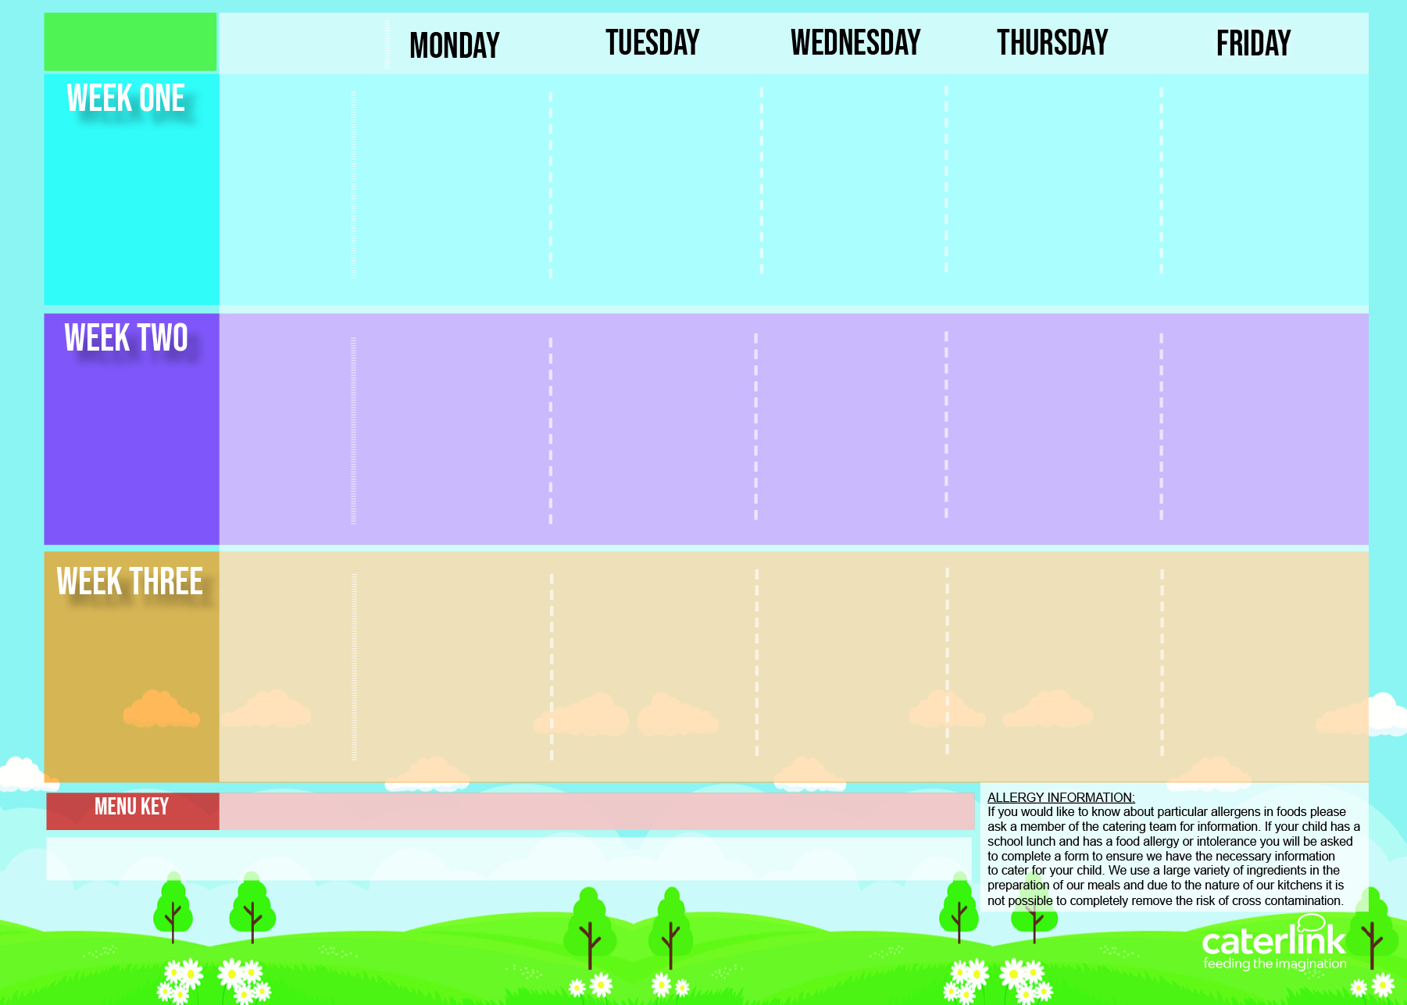




Autumn/ Winter
2023/ 2024
Option one
Cheese and Tomato Pizza
* Beef & Bean Burger in a Bun with Potato Wedges
Vegan Burger in a Bun with Potato Wedges
* Roast Pork, Stuffing Roast Potatoes & Gravy
* Spaghetti Bolognaise
MSC Fishfingers with Chips & Tomato Sauce
30/10/2023
20/11/2023
11/12/2023
15/01/2024
05/02/2024
04/03/2024
25/03/2024
Option two
NEW Chef Mariam’s Vegetable Couscous
Veg Wellington, Stuffing, Roast Potatoes & Gravy
Veggie Bolognaise
Cheesy Bean Pasty with Chips & Tomato Sauce
Vegetables
Sweetcorn
Roasted Peppers
Roasted Tomatoes
Green Beans
Cabbage
Peas
Broccoli
Carrots
Baked Beans
Peas
Dessert
Fruit Jelly
with Mandarins
Fresh Fruit Salad
Apple Cake with Custard
Chocolate Orange Cookie
with Yoghurt
Lemon Drizzle
Option one
Macaroni Cheese
* Sausages with Potato Wedges
* Lemon & Herb Chicken with Roast Potatoes and Gravy
Lemon & Herb Quorn with Roast Potatoes and Gravy
* Chicken Korma with Rice
MSC Salmon Fishcakes with Chips & Tomato Sauce
06/11/2023
27/11/2023
18/12/2023
22/01/2024
19/02/2024
11/03/2024
Veggie Sausages with New Potatoes
NEW Loaded Jackets
Veggie Meatballs in Tomato Sauce with Rice
Cheese Omelette with Chips & Tomato Sauce
Option two
Vegetables
Roasted Peppers
Green Beans
Sweetcorn
Roasted Vegetables
Broccoli
Swede
Baked Beans
Peas
Carrots & Peas
Chocolate Drizzle Cake with Chocolate Sauce
Dessert
NEW Carrot Cake
Apple Crumble with Custard
Ice Cream with Peaches
Vanilla Shortbread
with Yoghurt
Option one
Creamy Tomato Pasta
Sweet Potato & Spinach Flan with Couscous
* Mexican Beef
with Rice
* Roast Chicken with Roast Potatoes and Gravy
* Chicken Pie with
New Potatoes
MSC Fishfingers with Chips & Tomato Sauce
13/11/2023
04/12/2023
08/01/2024
29/01/2024
26/02/2024
18/03/2024
Option two
Vegetable Fajitas
with Rice
Veggie Sausages with Roast Potatoes and Gravy
Lentil & Sweet Potato Curry with Rice
BBQ Quorn Fillet with Chips
Vegetables
Roasted Vegetables
Sweetcorn
Green Beans
Roasted Tomatoes
Cauliflower
Peas
Broccoli
Carrots
Baked Beans
Peas
Dessert
Iced Sponge
Rice Pudding with Mixed Berries
Fresh Fruit Salad
Melting Moment Biscuit with Yoghurt
Peach Upside Down Cake with Custard
Added Plant Power
Wholemeal
Vegan
Chef’s Special
* Halal Alternative Available
Allergy Information
If your child has an allergy or intolerance please contact the School Office. You will be asked to complete the Caterlink special diets allergy form and provide NHS medical evidence of the allergies or intolerances before your child can receive a school meal. We use a large variety of ingredients in the preparation of our meals and due to the nature of our kitchens it is not possible to completely remove the risk of cross contamination.
Available Daily: - Freshly cooked jacket potatoes with a choice of fillings - Bread freshly baked on site daily- Daily salad selection

