Slide 1
History of the Internet
1992 – Ten websites
1997 – 1 Million websites
2001 – 29 Million websites
2005 – 65 Million websites
2010 – 200 Million websites
2015 – 1 Billion websites

Slide 2
Internet usage in one day
Internet users - 2,690,000,000 Approx
E mail Messages - 130,000,000,000 Approx
Google Searches - 1,500,000,000 Approx
Usage in 1 Minute
25,000 items bought from Amazon
67,000 Photos uploaded onto Instagram
100,000 Youtube Videos viewed
571 New Websites registered

Slide 4
Important Instagram Terms & Conditions
You must be at least 13 years old to use the Service
You may not post violent, nude, partially nude, discriminatory, unlawful, infringing, hateful, pornographic or sexually suggestive photos or other content via the Service
Instagram does not claim ownership of any content that you post on or through the Service. Instead, you herby grant to Instagram a non-exclusive, fully paid and royalty-free, transferable, sub-licensable, worldwide licence to use the Content that you post on or through the service, subject to the Service’s Privacy Policy

Slide 5
Only post on social media if :-
You would be happy if your parents see it
You would be happy if your children see it
You would be happy if it was posted on the front page of a newspaper
You would be happy for your enemy to see it
You would be happy to see it in 5 years time

Slide 6
Smart Rule
Safe – Do not share personal information, email, phone numbers, address and passwords.
Meeting – Never meet someone you have only met online.
Accepting – Do not open emails, texts and files from an unknown source, this can lead to malware or a virus.
Reliable – Information on the internet is not always true. People post false details.
Tell - Inform a parent or carer or a trusted friend/teacher if anything online makes you feel uncomfortable or worried.

Slide 7
According to the Child Exploitation and Online Protection Centre most child sexual exploitation offences take place online. These offences include deceiving children into producing indecent images of themselves, engaging in sexual chat online or sexual activity over a webcam.
Analysis by the centre reveals that 13 and 14 year olds represent the largest single victim group.

Slide 8
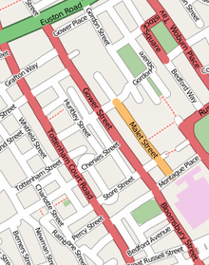
Geo Location Services
Digital Images taken on a phone camera can also expose your location

Slide 9
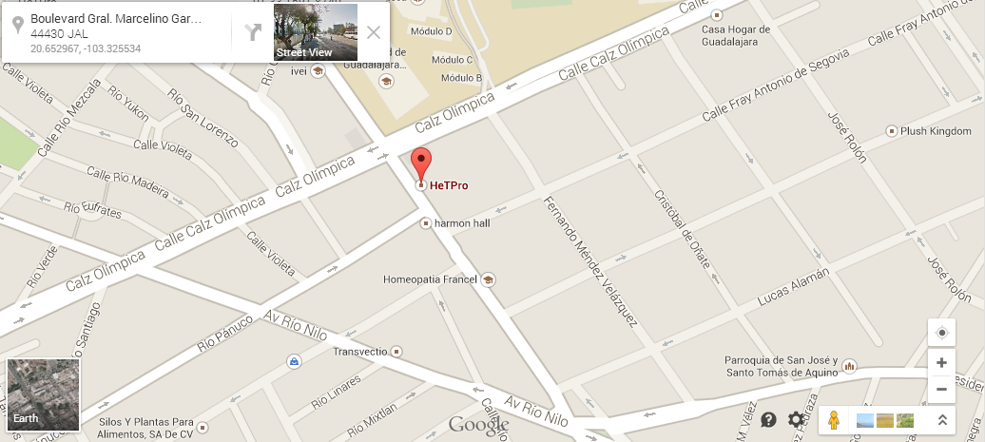

Slide 10
CYBER - BULLYING TRAITS
It is an invasion of personal space for young people and is all encompassing
and penetrating.
The audience can be large, reached rapidly and can be unknown
It is easier for perpetrators to remain anonymous through the online
world or masquerade as another person
The target of bullying can be anyone as physical and other factors do
not come into play.
Often young people who engage in cyber-bullying get involved in an
unintentional way.
There is a disconnection as they are removed from the face to face.
There is an evidence trail in the online world therefore there is the ability
to track people

Slide 11
Advise for young people and their families regarding cyber-bullying
Tell someone you trust
Report any cyber-bullying, even if it’s not happening to you
Never respond/retaliate as it could make matters worse
Block the cyber-bullies from contacting you
Save and print any bullying messages, posts, pictures or videos that
you receive
Make a note of the dates and times they are received
Keep your passwords private
Don’t post any personal information or pictures online

Slide 12
Digital Footprint
Try googling yourself and your family, this will show your
digital footprint.
Click on images when googling to see what pictures of your
family maybe out there.
If you find something inappropriate then so can someone
else.
Google will remove personal information if requested to do
so.

Slide 13
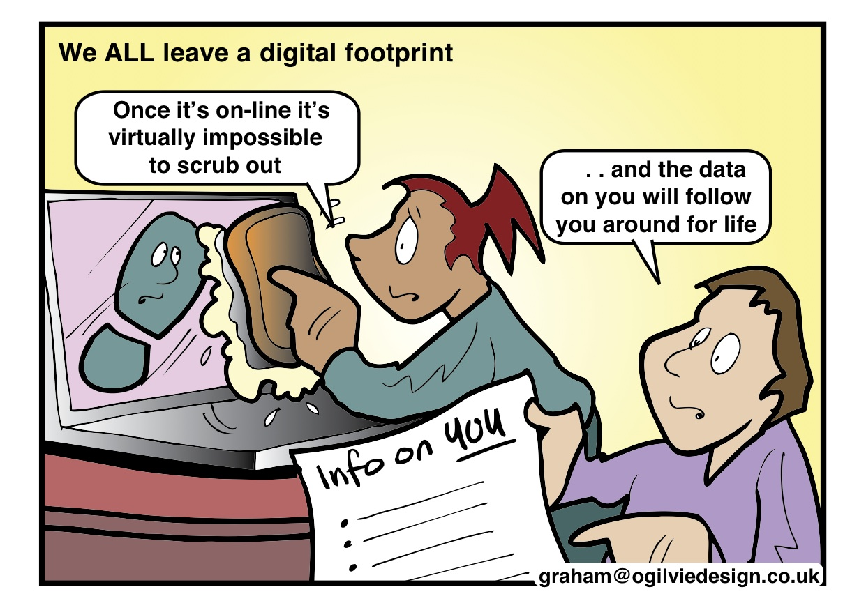

Slide 14
Reputation Management
Always be careful when you post something online or upload a photograph
Once it is sent or uploaded it may stay there for ever
If it is copied or resent, then you may never be able to remove it
When you apply for a University or your first job, you will probably be Googled.
Other people will be able to find out what you have said and done on Social Media,
Think before you click

Slide 15
Paris Brown 17 Years Old
Youth Police and Crime Commissioner for Kent.
She lost her job after 7 days because a newspaper found out that when she was 14 years old, she had posted some inappropriate comments onto Social Media.

Slide 16
Key Messages - Summary
Know who you’re talking to, people aren’t always who they say they are
Learn how to use and set security settings across a range of devices
Keep your personal information private
Know how to report on sites and services you are using
Implications of children having unsupervised access to the world wide web
Understand digital footprint:
Uploading Self-taken images and videos
Location-based photographs – Geo tagg
Future implications of actions of online behaviour
How to report to sites
CEOP (Child Exploitation Online Protection)
NSPCC
IWF (Internet Watch Foundation)

Slide 17
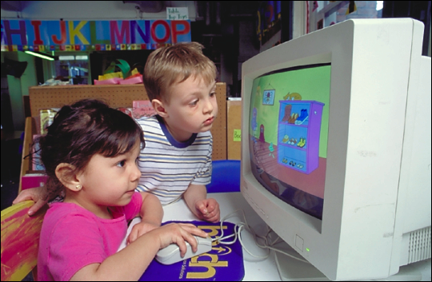
Safe search platforms for Children
There are some search providers designed for children
www.swiggle.org.uk
www.kidclicks.org
www.kidrex.org
www.kidzsearch.com
www.safesearchkids.com
www.factmonster.com
www.gogooligans.com

Slide 18
So what can we do?

Slide 19
Safe search platforms for Children
There are some search providers designed for children
www.swiggle.org.uk
www.kidclicks.org
www.kidrex.org
www.kidzsearch.com
www.safesearchkids.com
www.factmonster.com
www.gogooligans.com

Slide 20
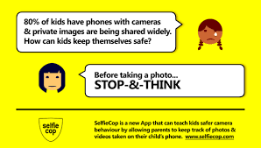

Slide 21
Youtube for kids app
Easy to set parental controls.
Limit which videos children can watch
Set a time limit
Switch off the search function
Set an age appropriate filter

Slide 22
PEGI
Pan European Games Information

Slide 23
The PEGI rating for this game is 12 years old. However, PEGI does not take chat features into consideration when rating games.
Fortnite Battle Royale says it does not direct the game to children under the age of 13 in the UK.
The App Store says that users must be 12+ to play.
There are in-app purchases, which can become expensive.
There is a chat feature in the game that allows users to contact each other using voice or text.
There is cartoon violence in the game. You can use a variety of weapons to kill other players, such as guns and axes.

Slide 24
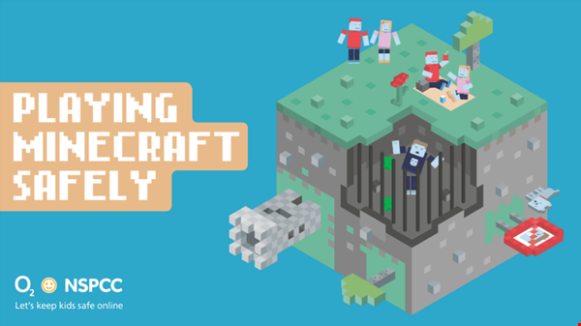
The world of Minecraft
Immerse yourself in the game with our infographic and learn how to talk to your child about staying safe.

Slide 25
Parental controls that will enable parents to shut-off chat capability.
Age visibility so that parents can easily determine that the settings for their kids are age appropriate.
More stringent chat controls for under 13s restricting a greater range of words

Slide 26
KD UK has announced that the Kurio Phone will be the first smartphone developed specially for kids.
The Kurio Phone looks like many other Android handsets on the market but safety is a key priority and as such has the firm's KurioGenius Parental Controls onboard. The smartphone itself has a 4in screen, Google Play and Kurio app stores, Wi-Fi, Bluetooth and a microSD card slot.

Slide 27
Thinkyouknow CEOP

Slide 31
Written by Lindsay Buck,
Childnet International
Illustrated by Ciara Flood

Slide 34
TIPS FOR PARENTS/CARERS
When you buy a game console/Mobile phone make sure you ask the vender about its online capabilities. Know what the equipment is capable of.
Think about the location of the game console. Keep it in a common area if possible. A family room is best for monitoring and supervision. Don’t allow children to have internet enabled devices in their bedroom until they reach an age and maturity to keep themselves safe.
Discuss the risks with your child. Don’t wait for something to happen before you talk to your child about the potential risks of gaming online. Ensure they have privacy settings activated and help them to understand why this needs to be done.
Gaming sites/Social Media often have ways of reporting abusive chat and blocking unwelcome contact from other users. – You should know how to do this.
Ask your child what they are playing or what Social Media they are using. Take an interest in your child’s on line life – just as you would if they were in a football team in the real world. Watch them playing and always keep lines of communication open.

Slide 35
What can you do now
Search yourself online
Check privacy settings
Use strong passwords
Update software
Think before you post
Review apps and remove any you are not using.
Build a positive reputation.
Set that very good example to your children when you use Social Media, e mails and the Internet.
operate online in a way which would not call into question your position as a professional;

Slide 36
Useful websites:
www.thinkyouknow.co.uk
www.internetmatters.org
www.kidsmart.org.uk
http://childnet.com
http://www.nspcc.org.uk
https://parentinfo.org
https://www.commonsensemedia.org
Notes:
Finally, here are some reminders:
ENDS.

